Slide 1
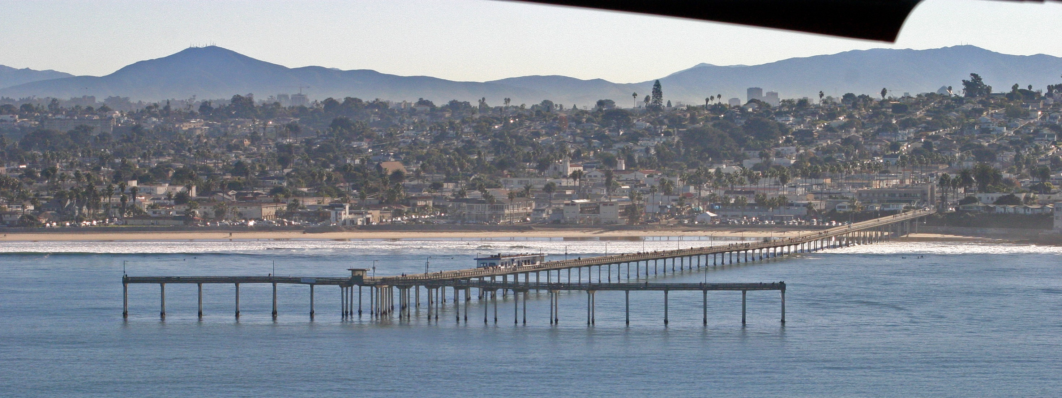
The Making of The Ocean Beach Fishing Pier
Presented by:
The Ocean Beach Historical Society – July 21, 2016
Presenter:
Ralph Teyssier, S.E.
Notes:
Welcome –
- Thanks to Pat James, President of OB Historical Society for the opportunity of

Slide 2
OB Pier Presentation -
Introduction
Engineering
Construction
1 Introduction

Slide 3
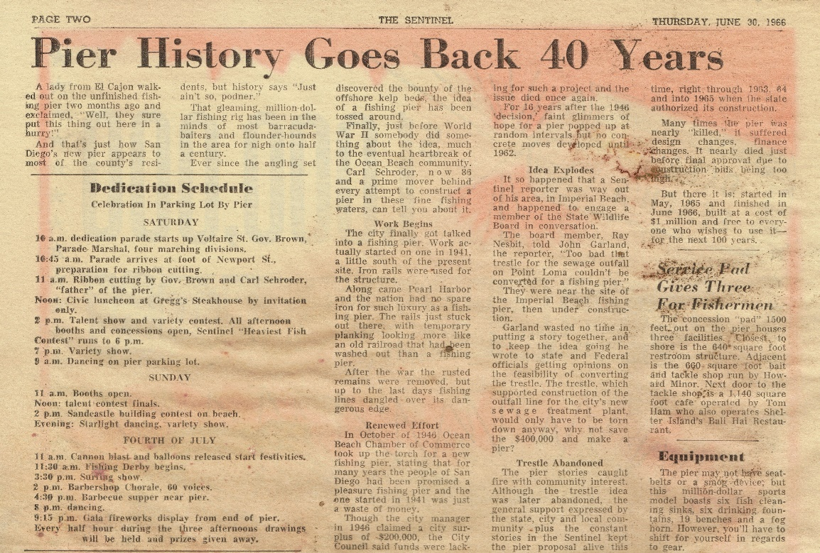
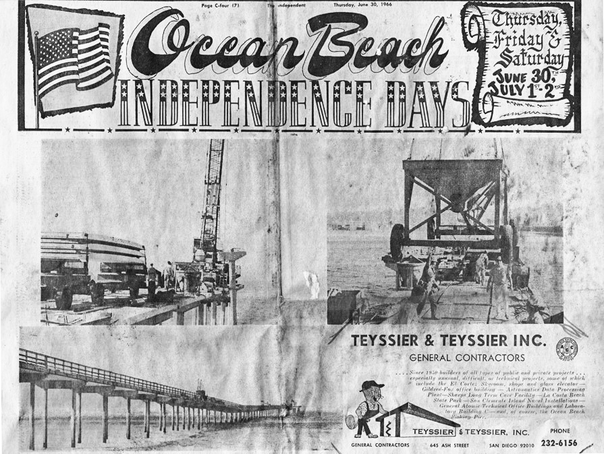
How OB Pier Came to be
1 Introduction

Slide 4
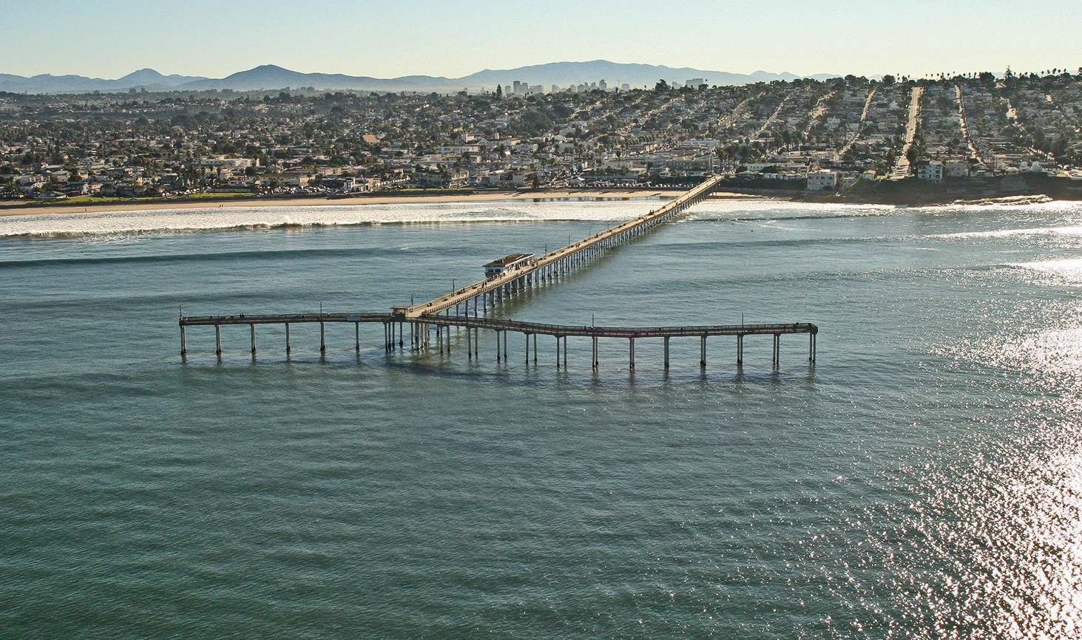
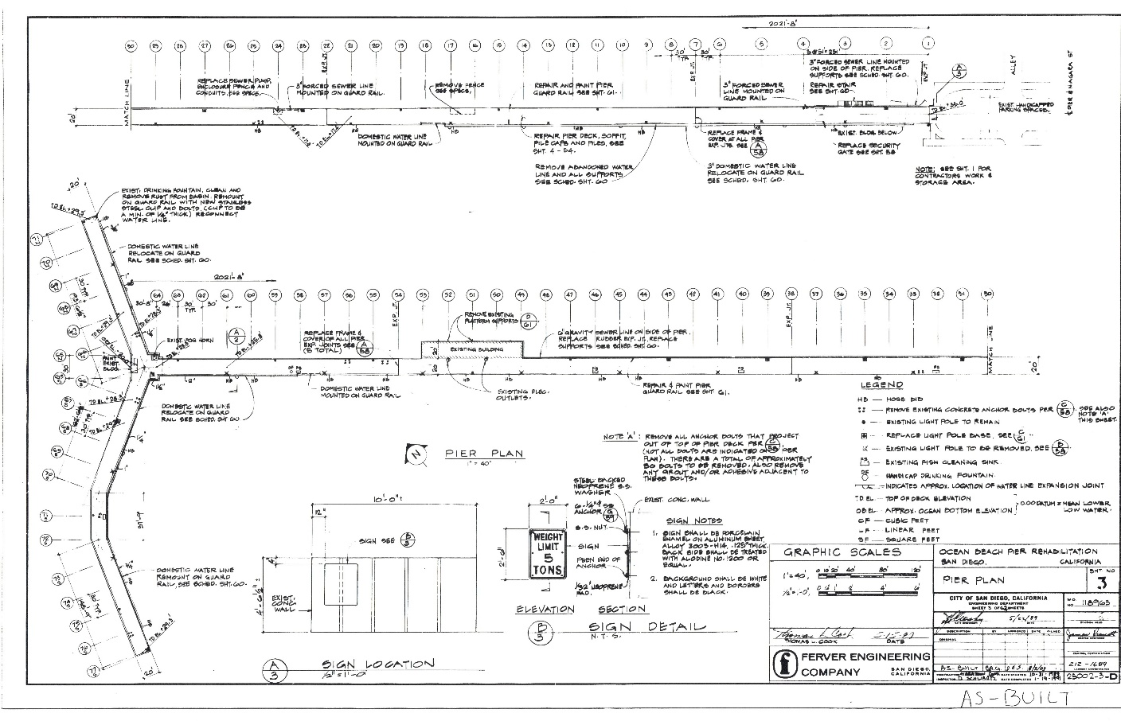
Plan Overview -
2 Engineering

Slide 5
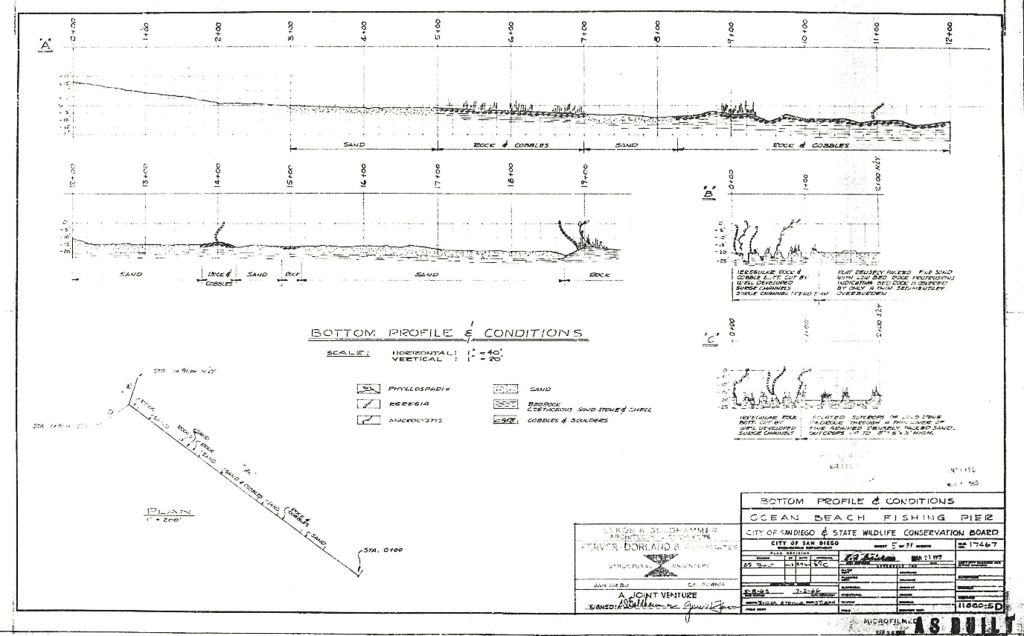
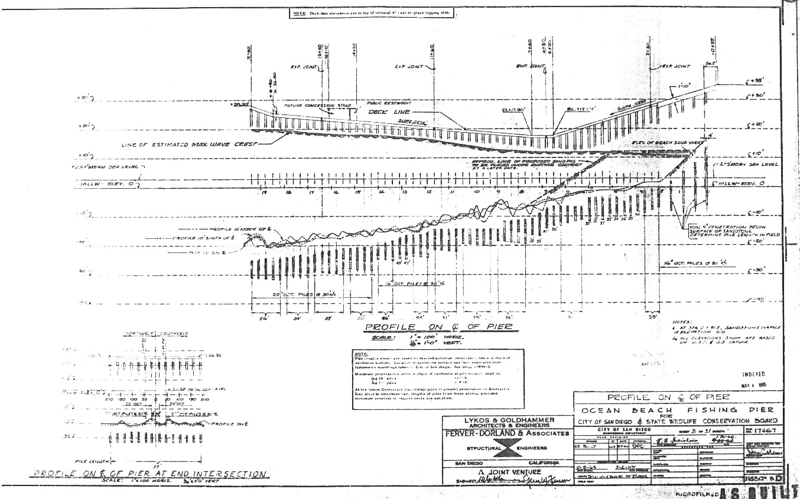
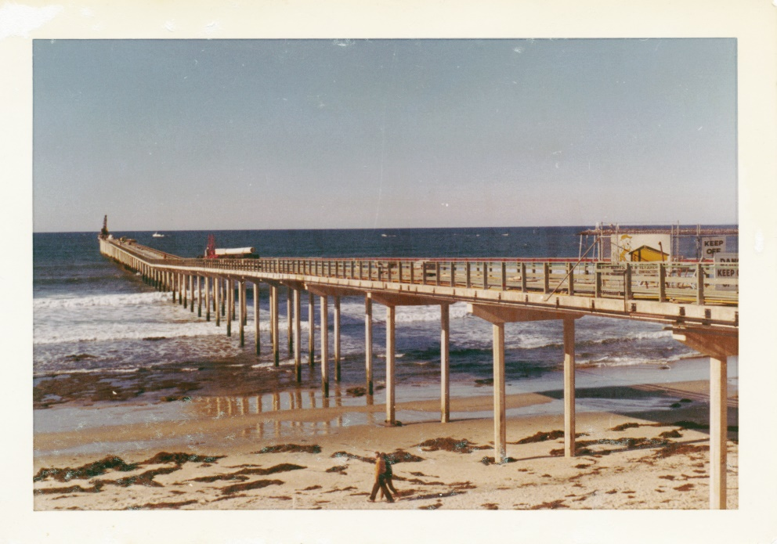
Shore & Pier Profiles
2 Engineering

Slide 6
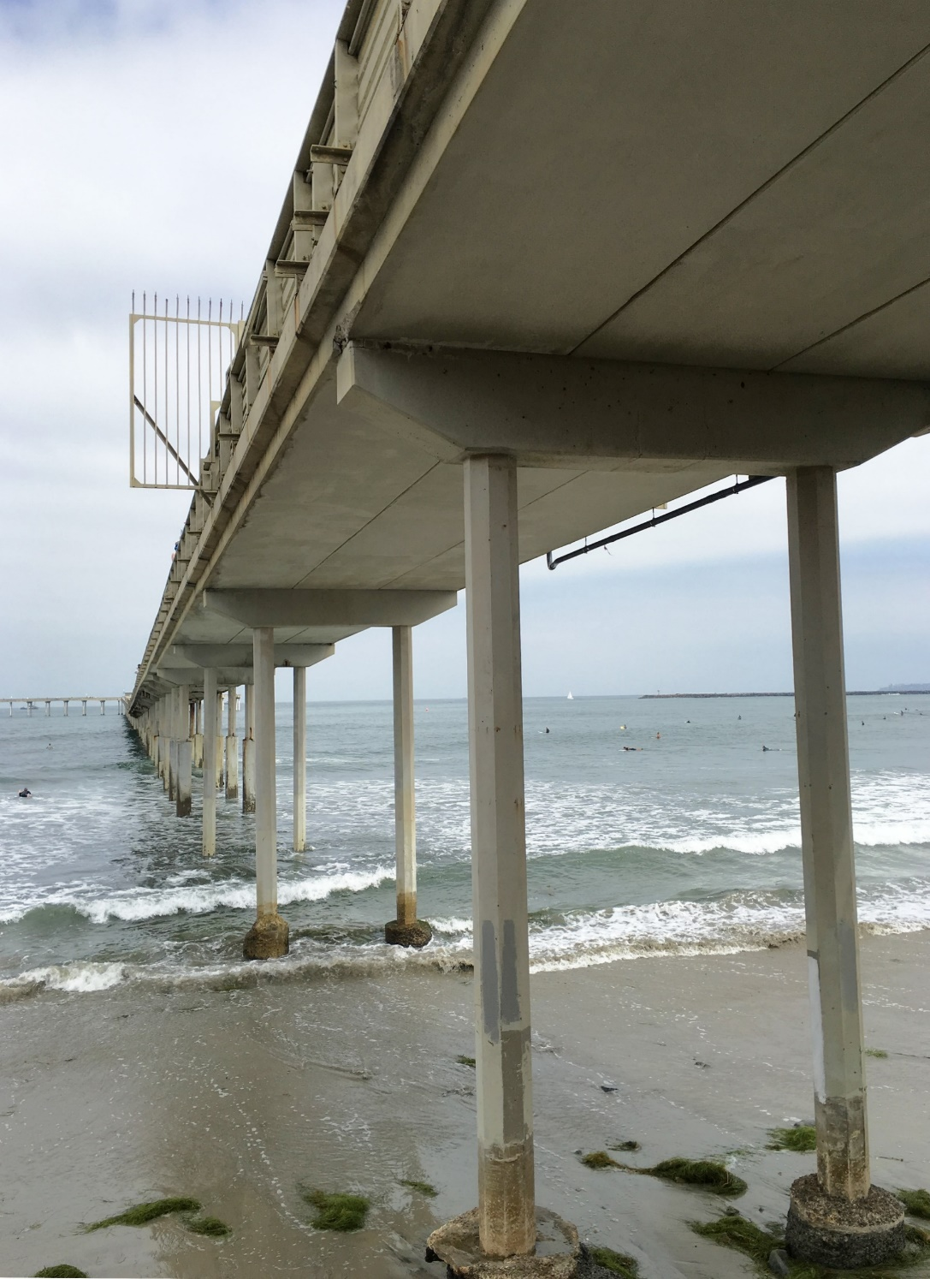
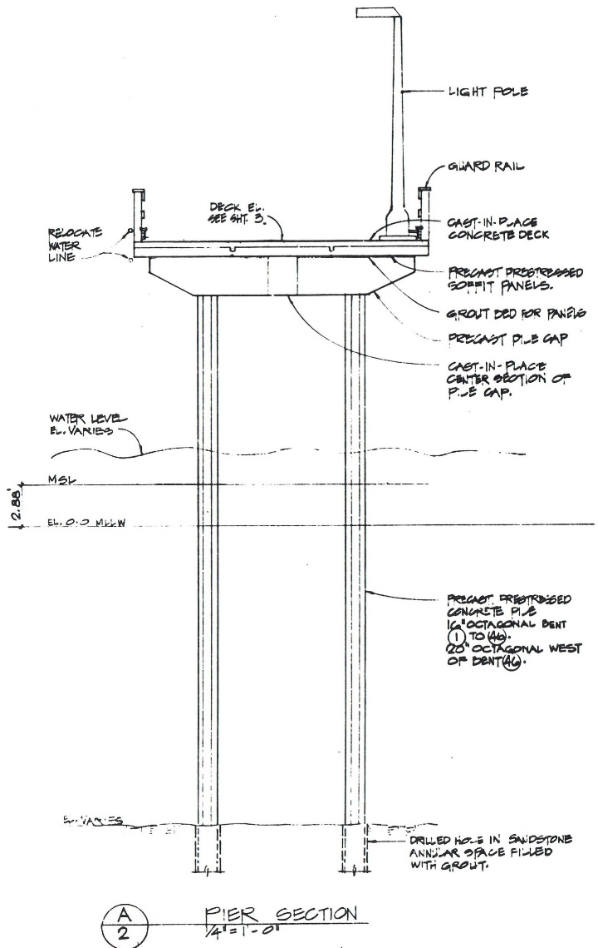
Pier Cross - Section
2 Engineering

Slide 7
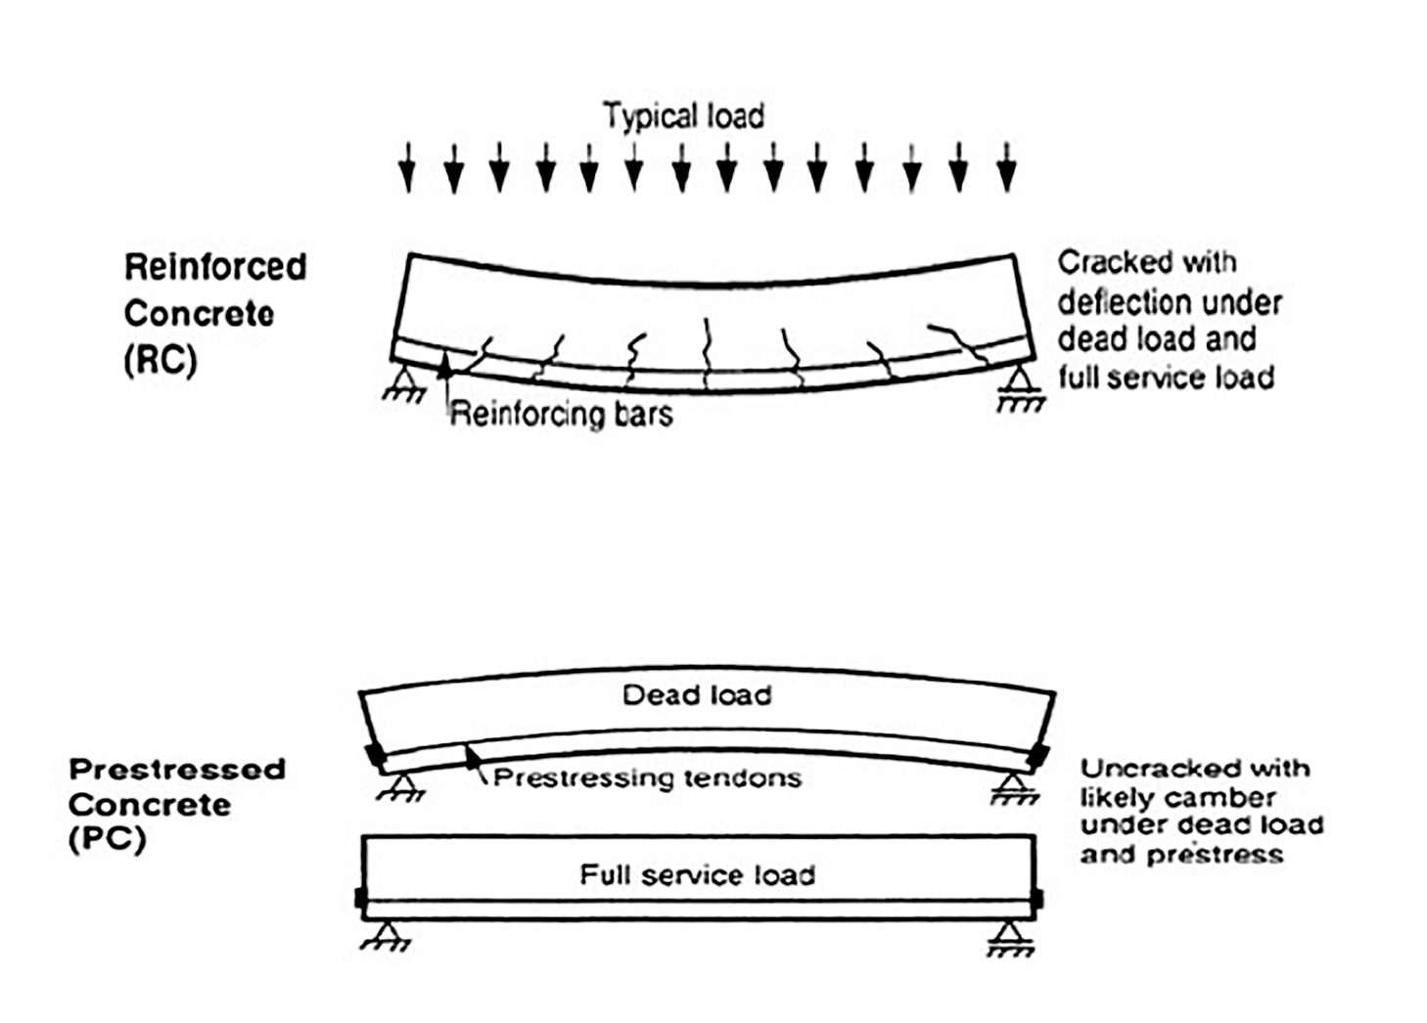
Structural Material - Prestressed Concrete
2 Engineering

Slide 8
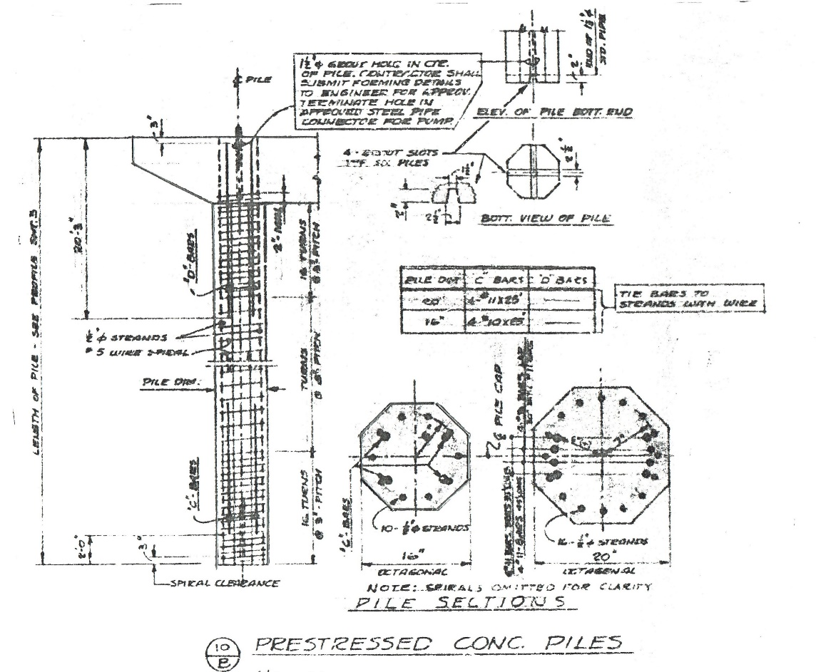
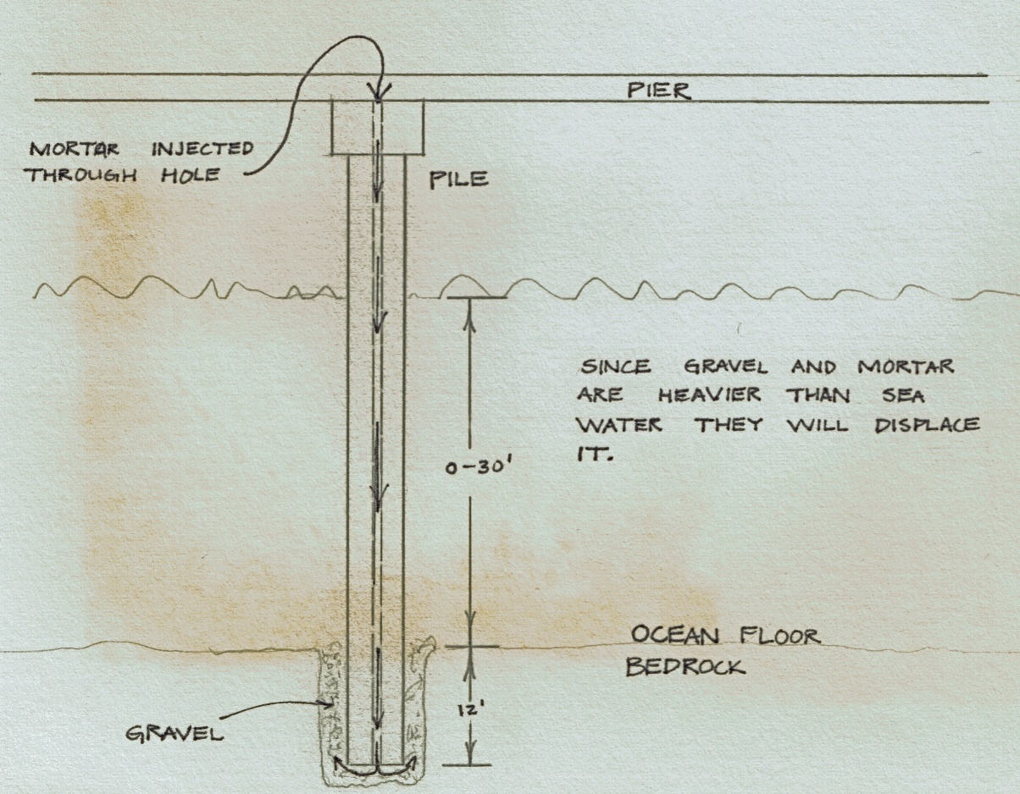
Hammerhead Pile
2 Engineering

Slide 9
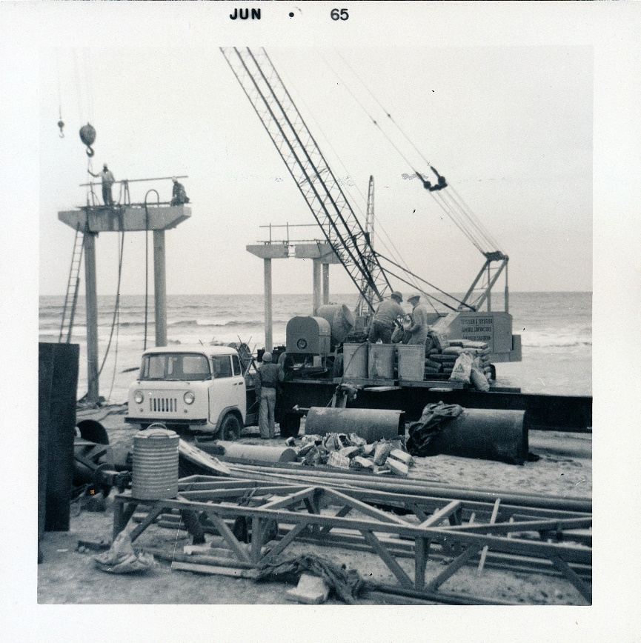
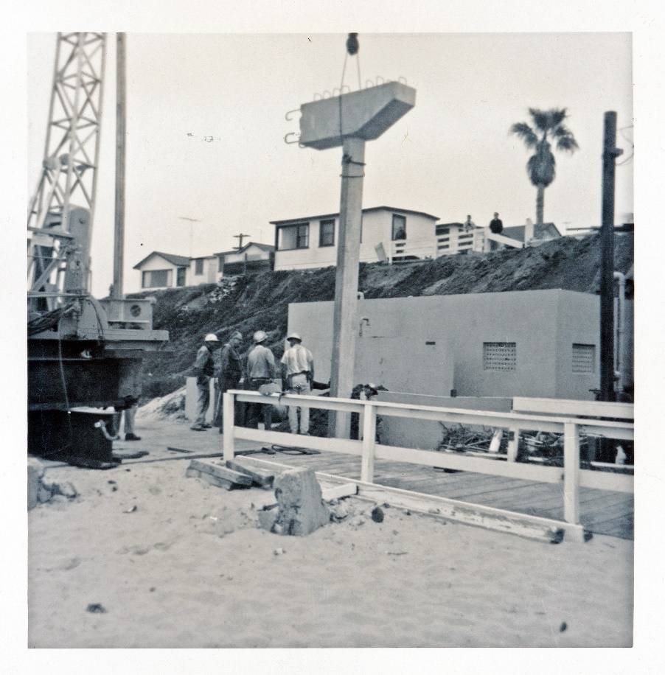
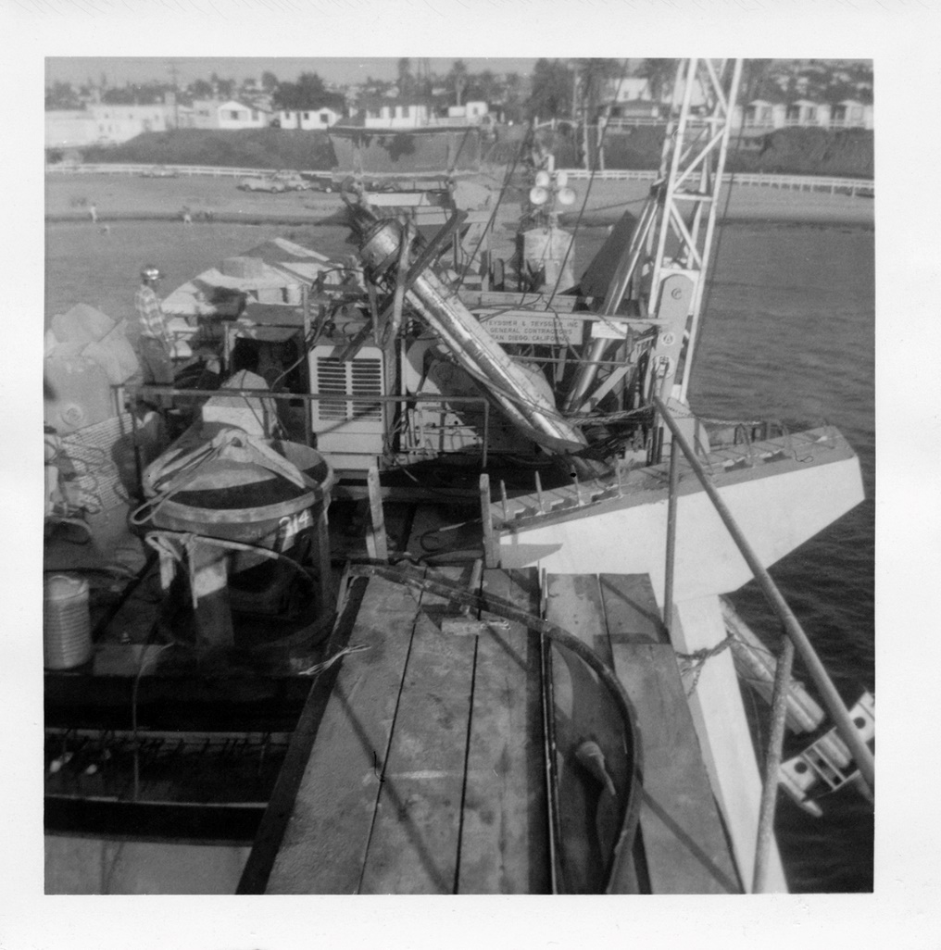
Hammerhead Pile
2 Engineering

Slide 10
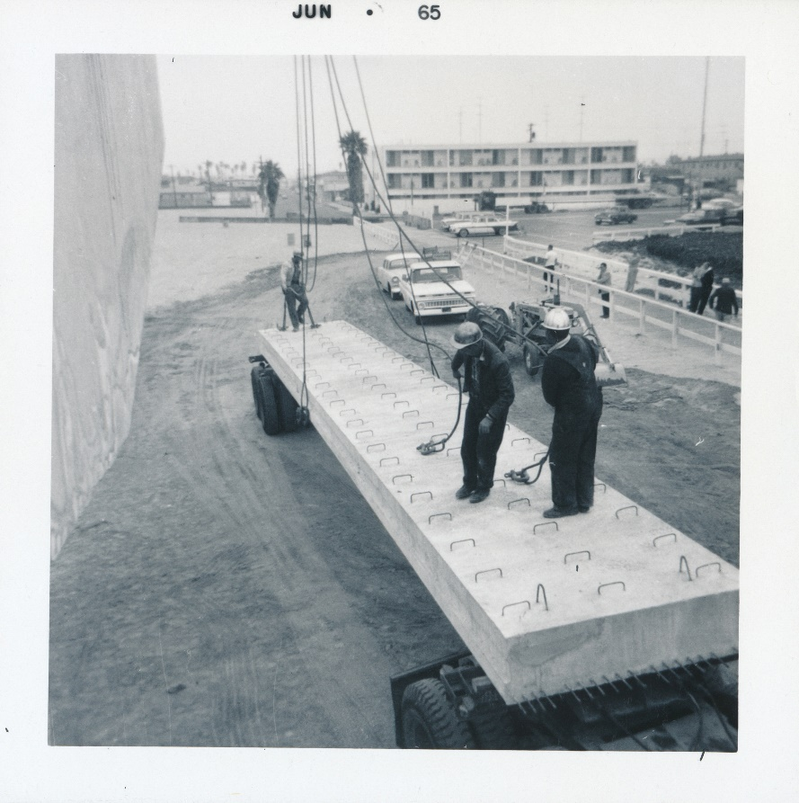
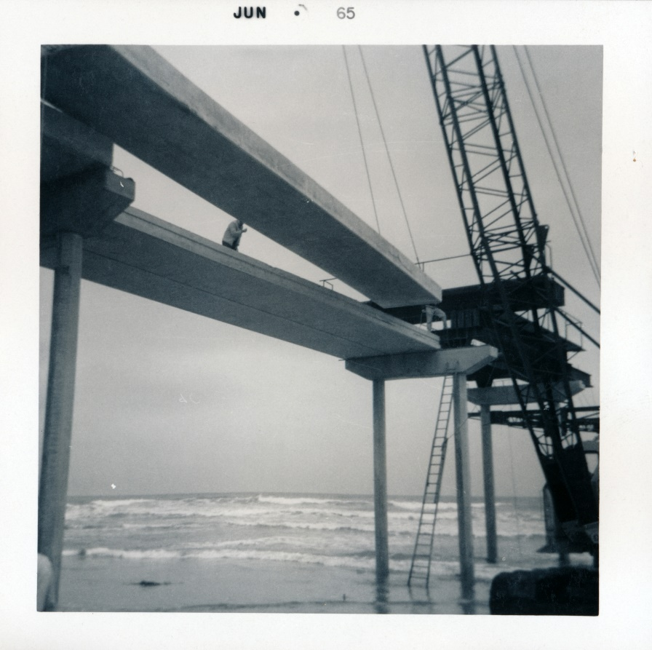
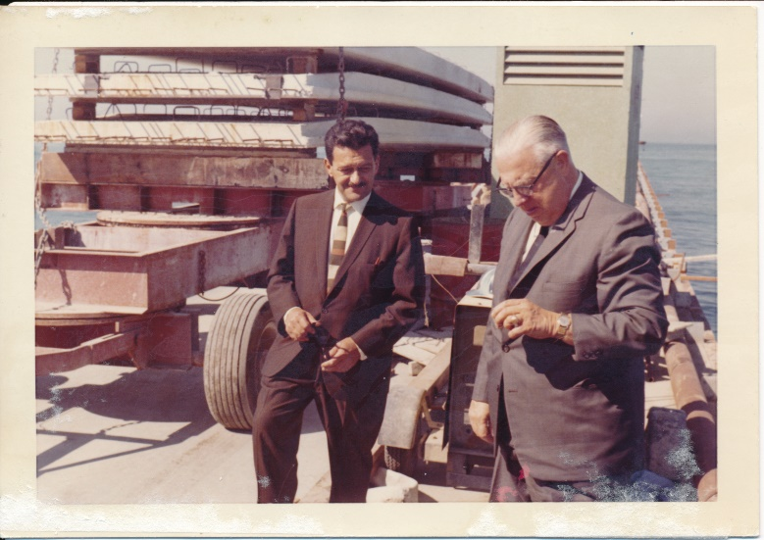
Pier Deck
2 Engineering

Slide 11
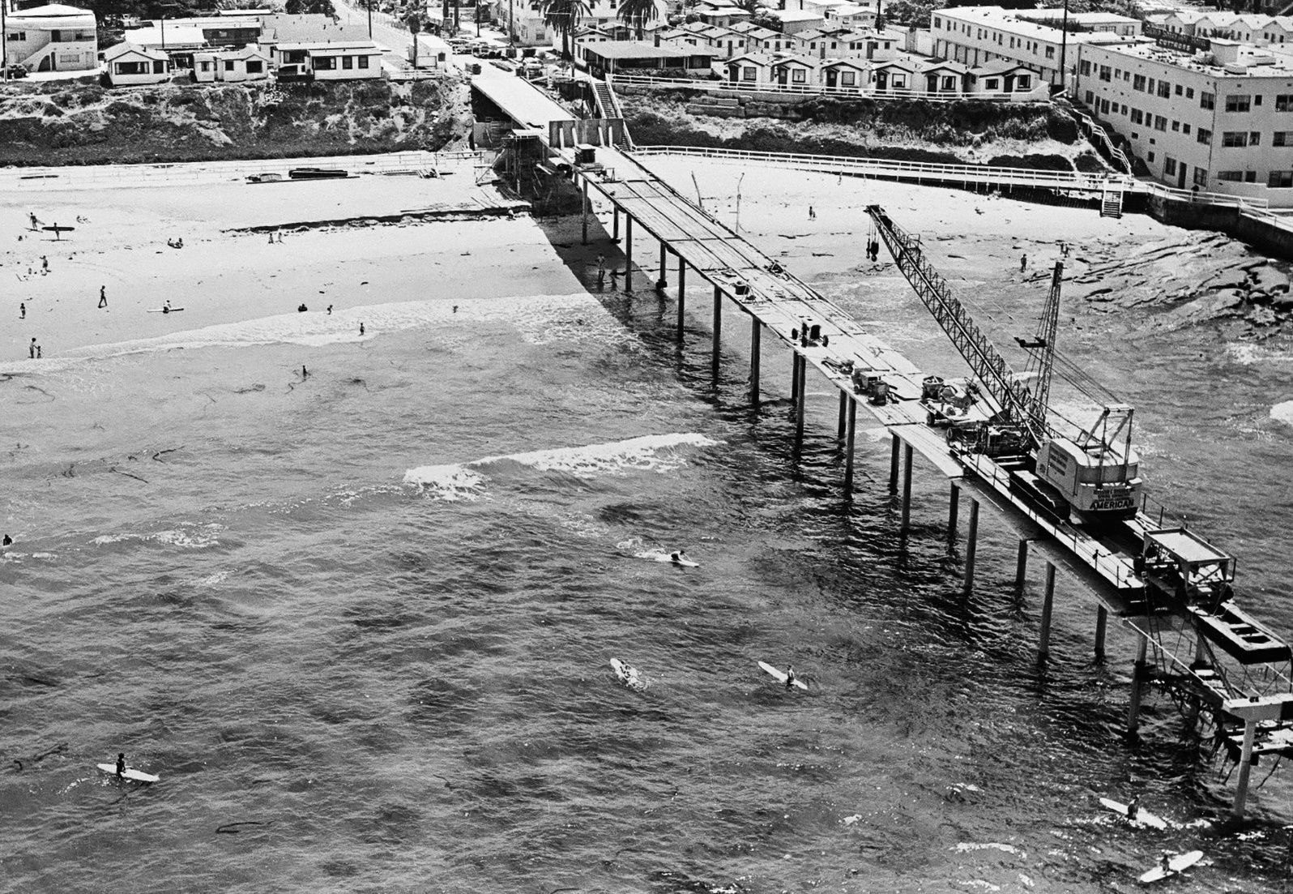
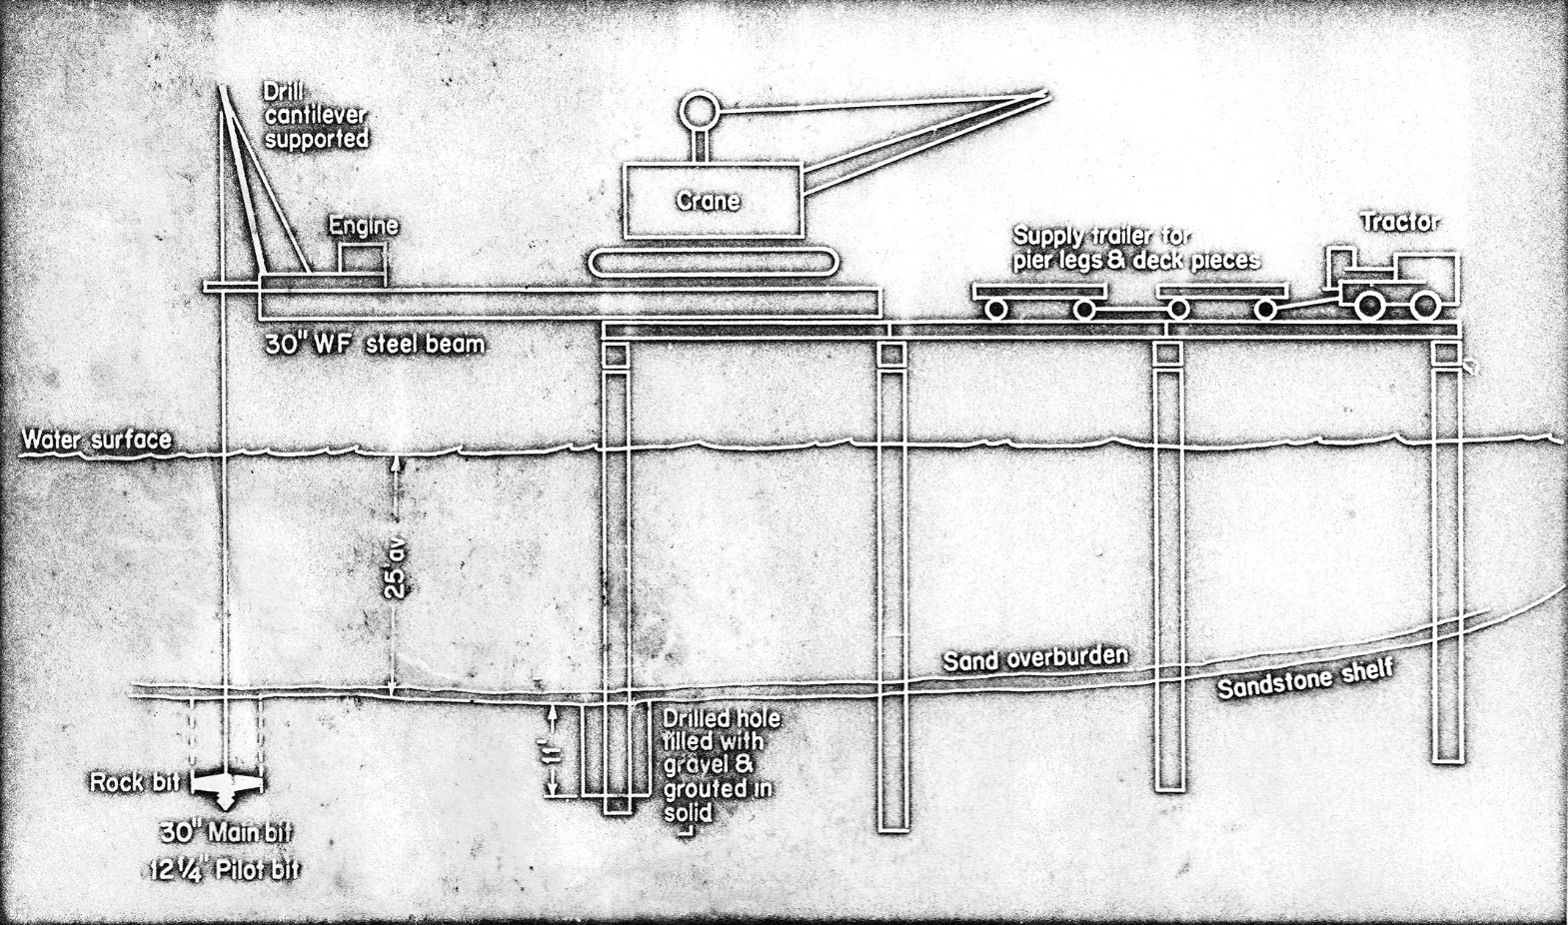
Construction Overview
2 Construction

Slide 12
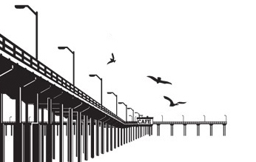
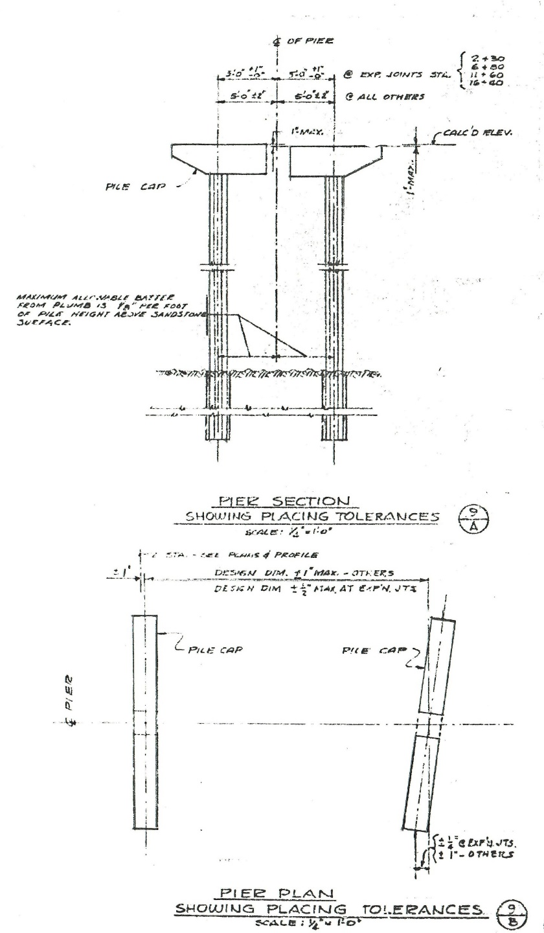
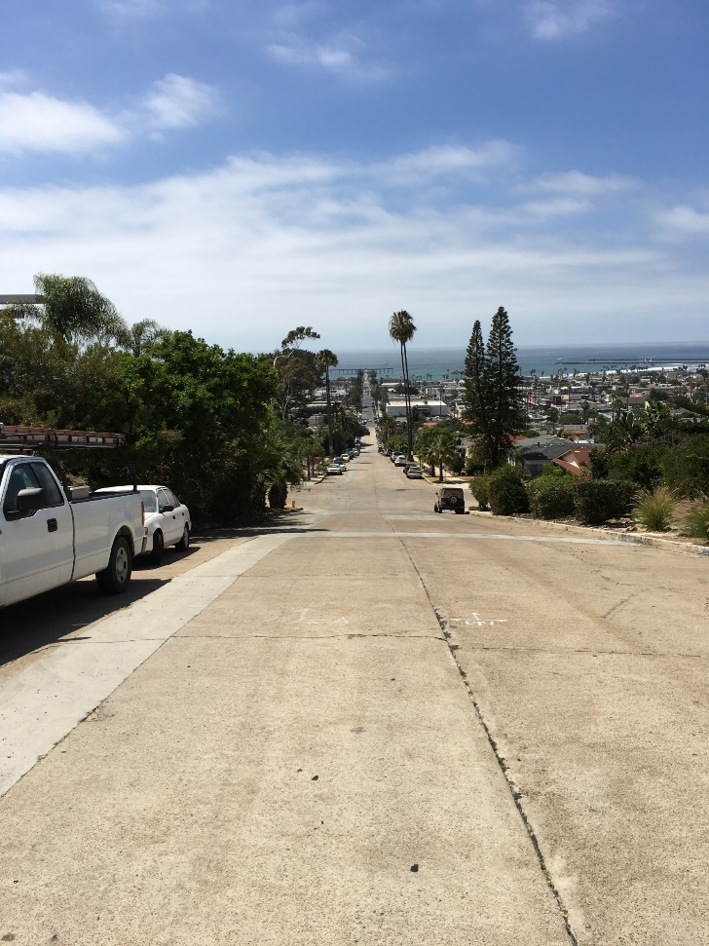
Construction – Alignment and Tolerances
Pier alignment and tolerances
2 Construction

Slide 13
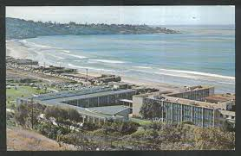
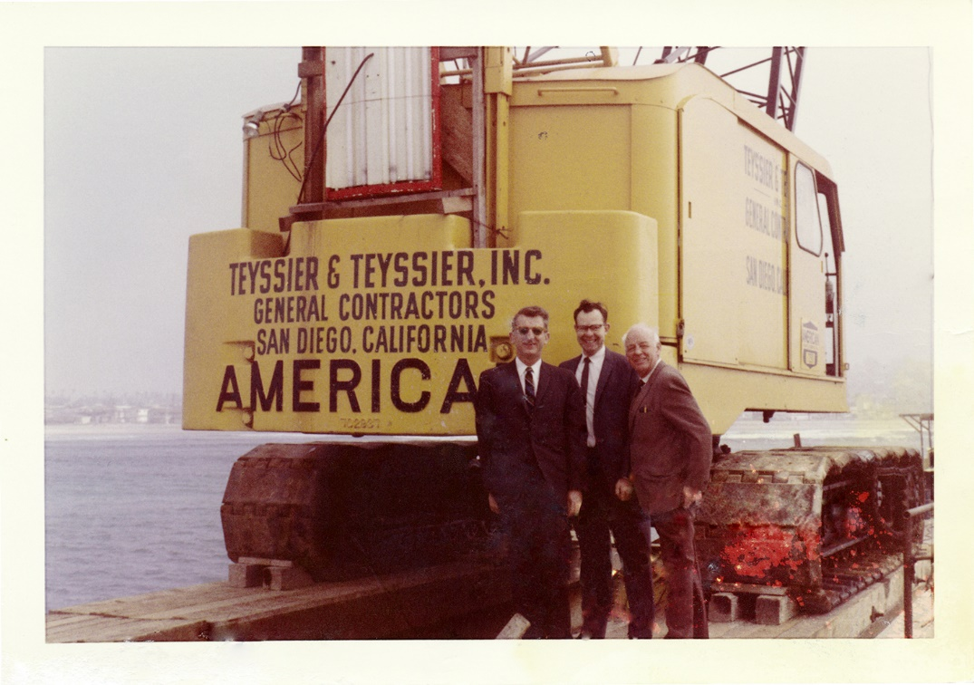
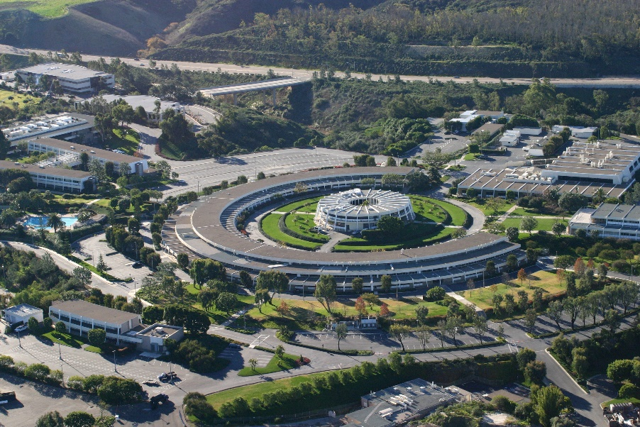
The Contractor
3 Construction

Slide 14
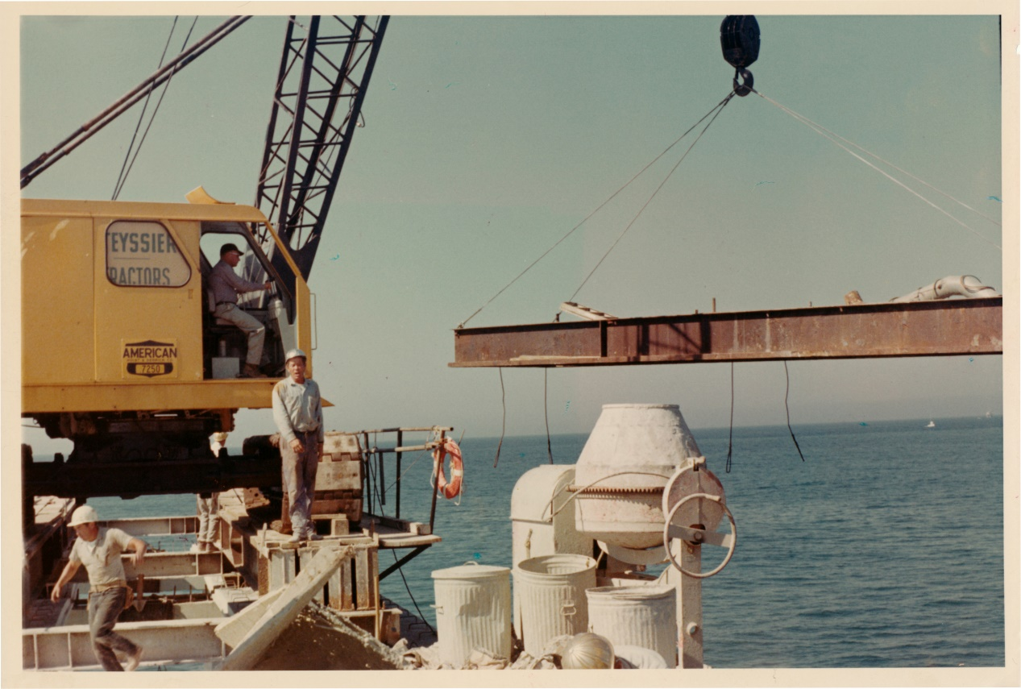
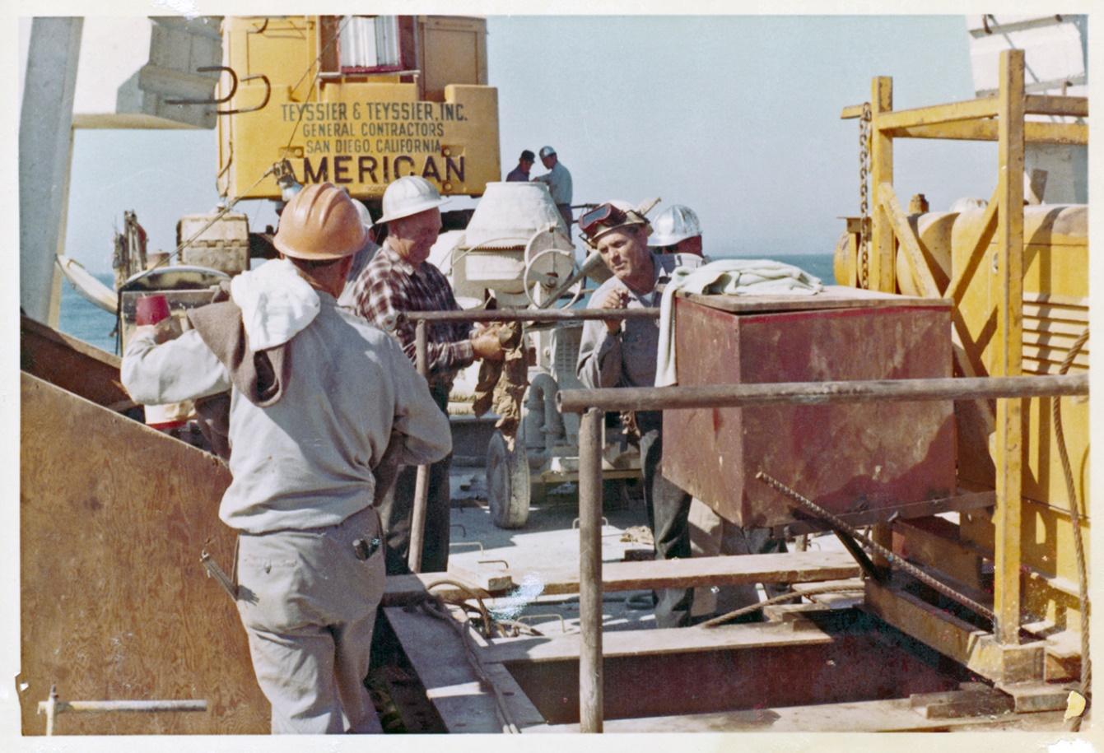
The Crew
3 Construction

Slide 15
The Equipment, Tools & Construction Sequencing
3 Construction

Slide 16
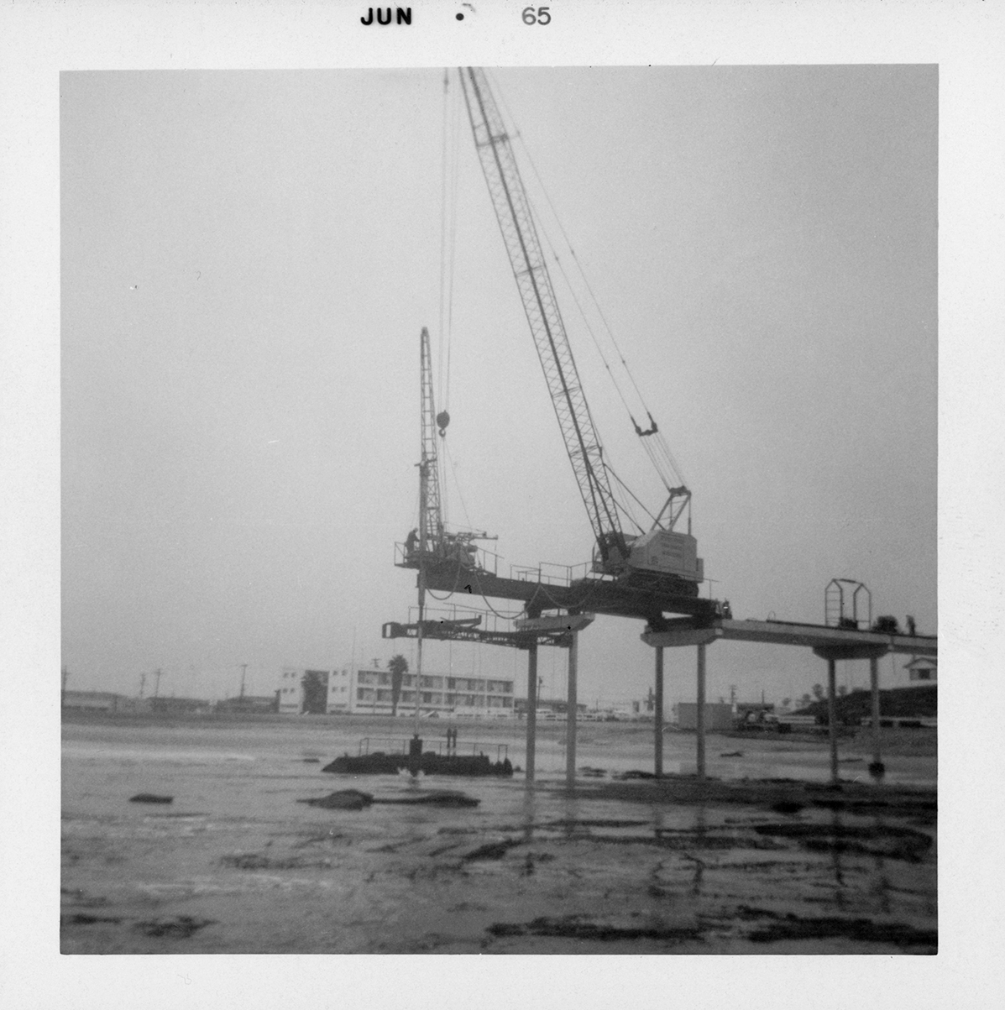
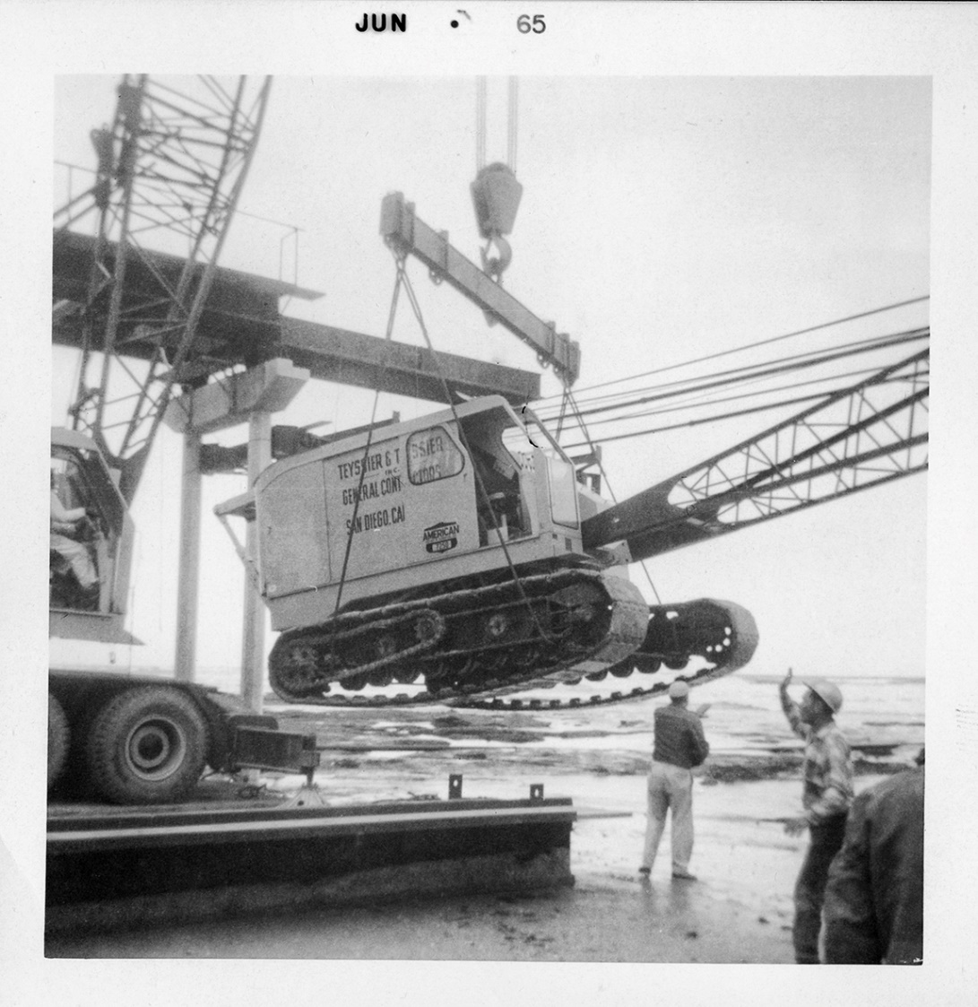
The Equipment & Tools - The Crane
3 Construction

Slide 17
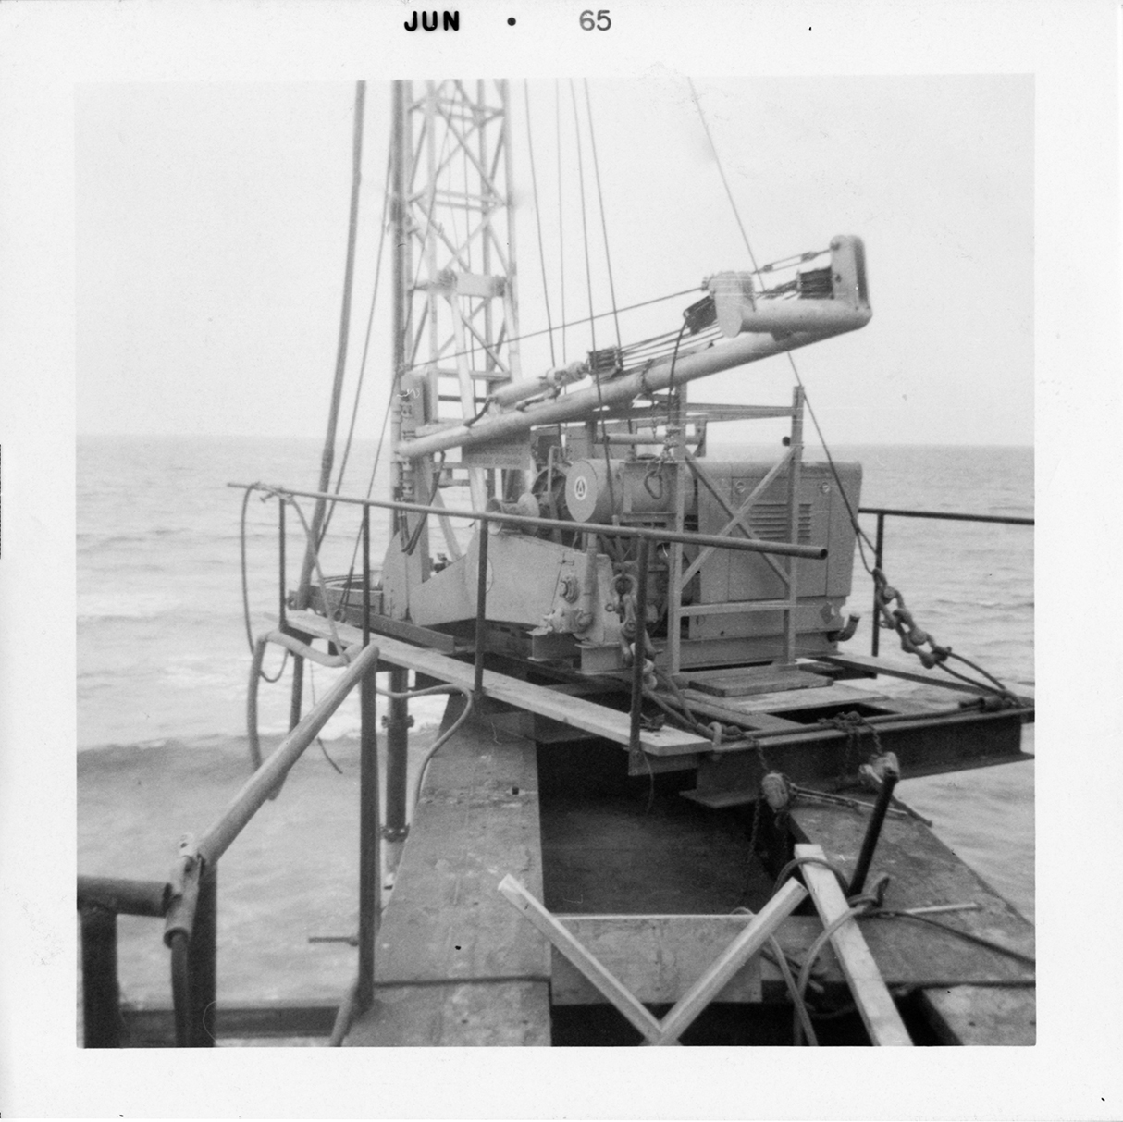
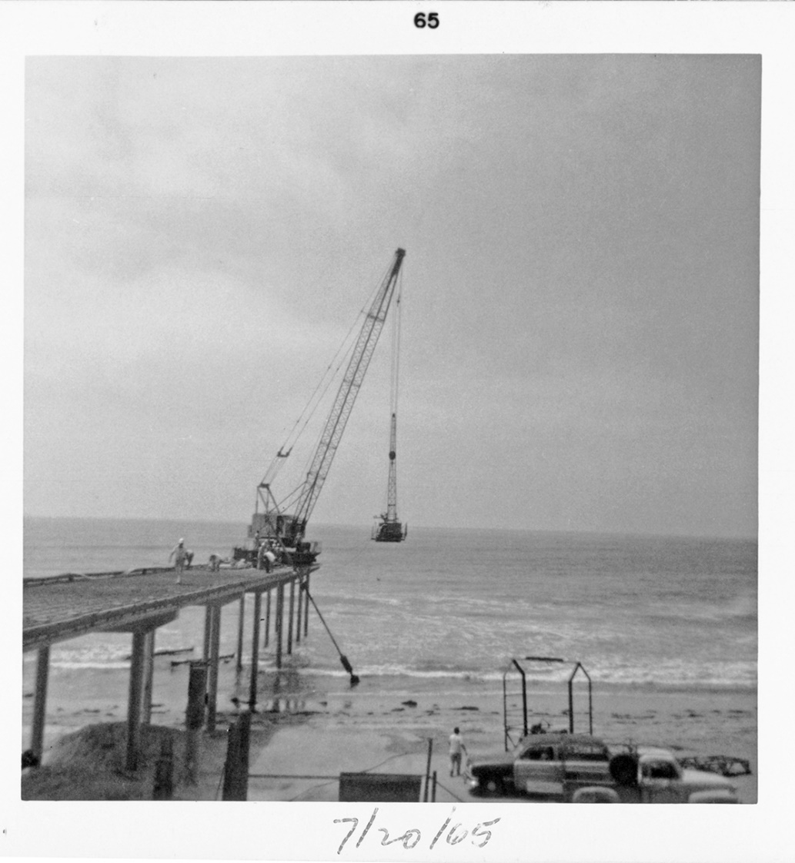
The Equipment & Tools - Drill Rig
3 Construction

Slide 18
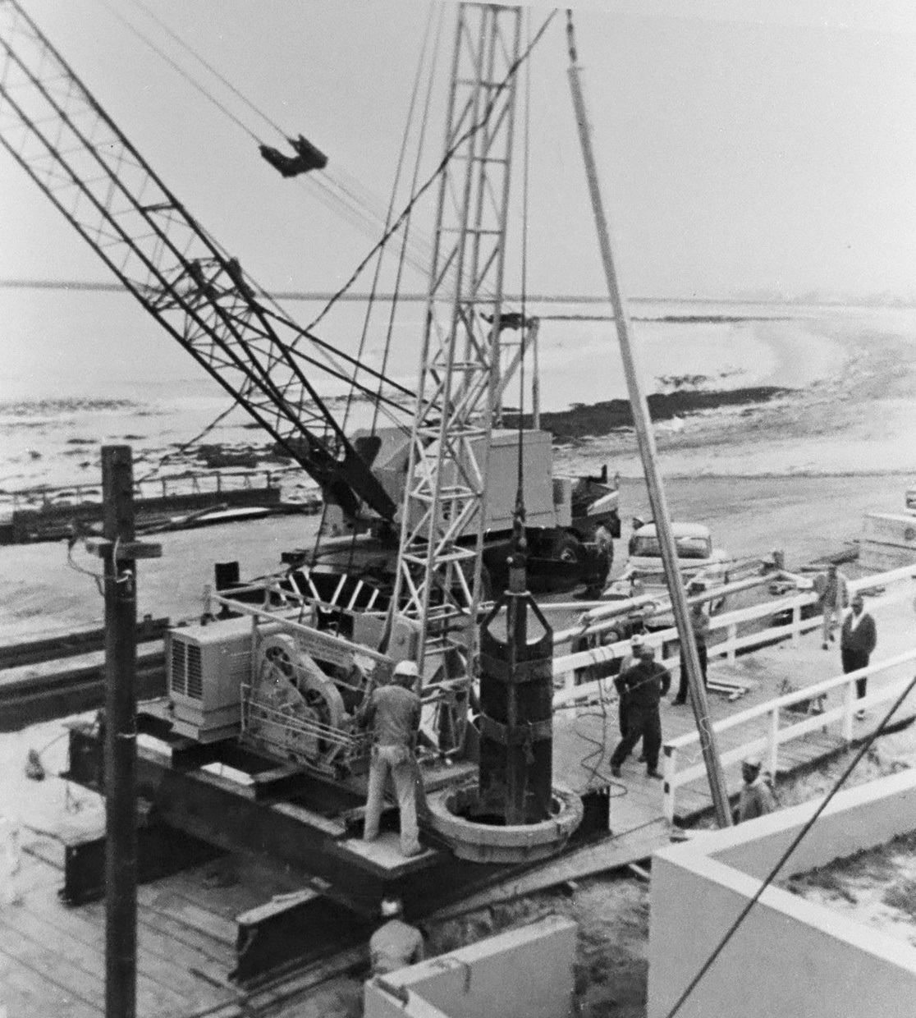
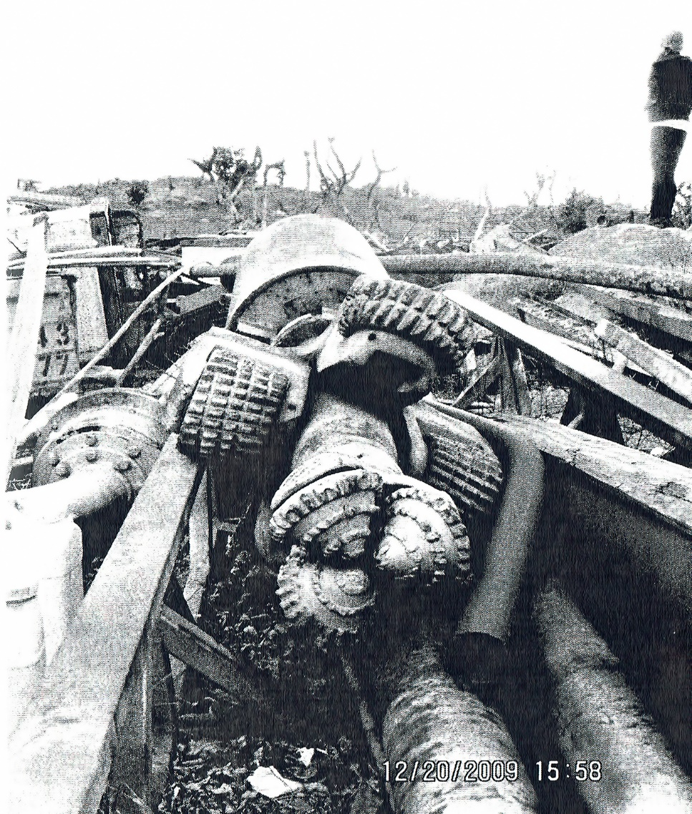
The Equipment & Tools - Drill Rig
2 Construction

Slide 19
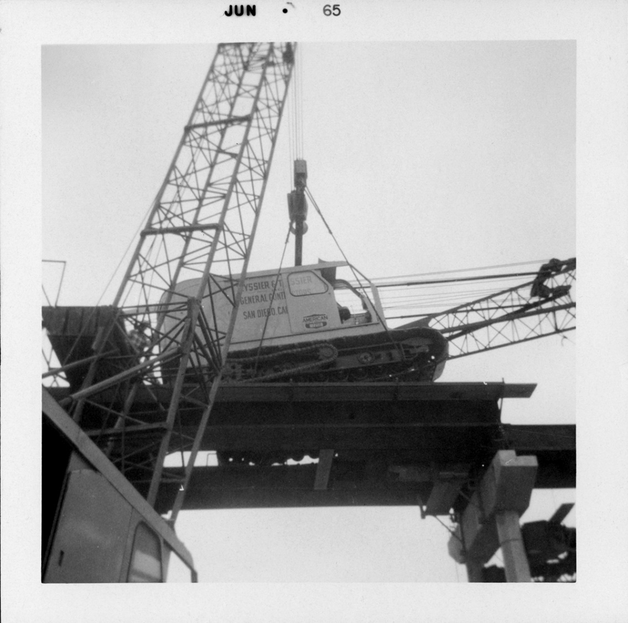
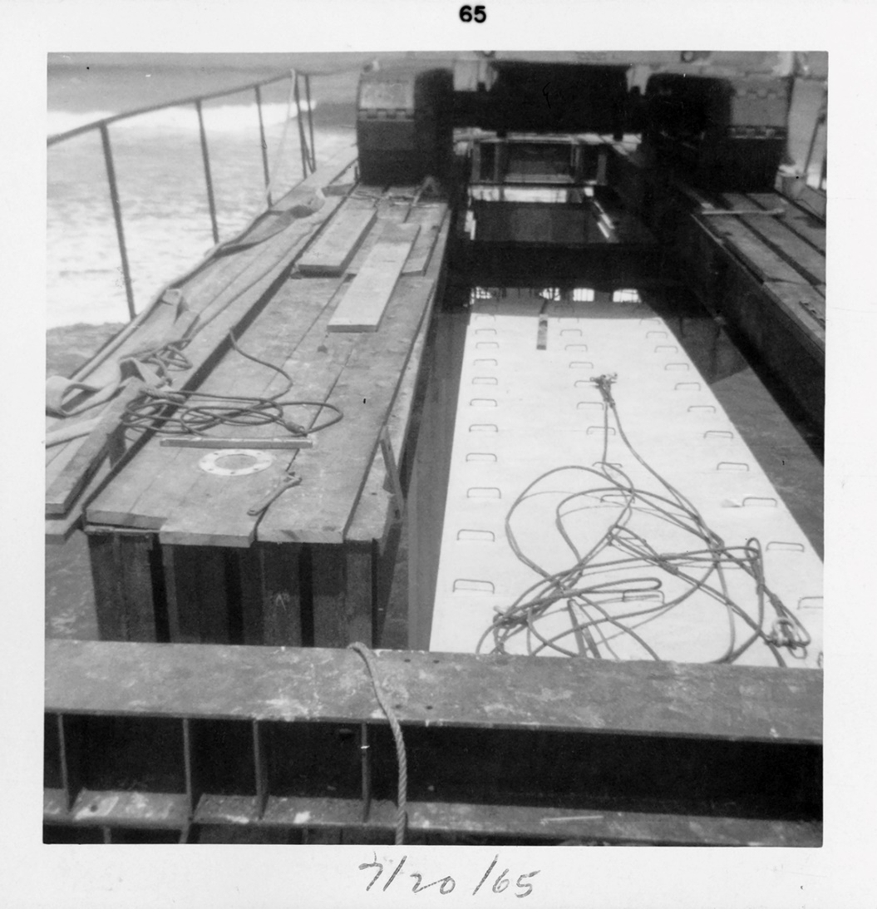
The Equipment & Tools - The Platforms
3 Construction

Slide 20
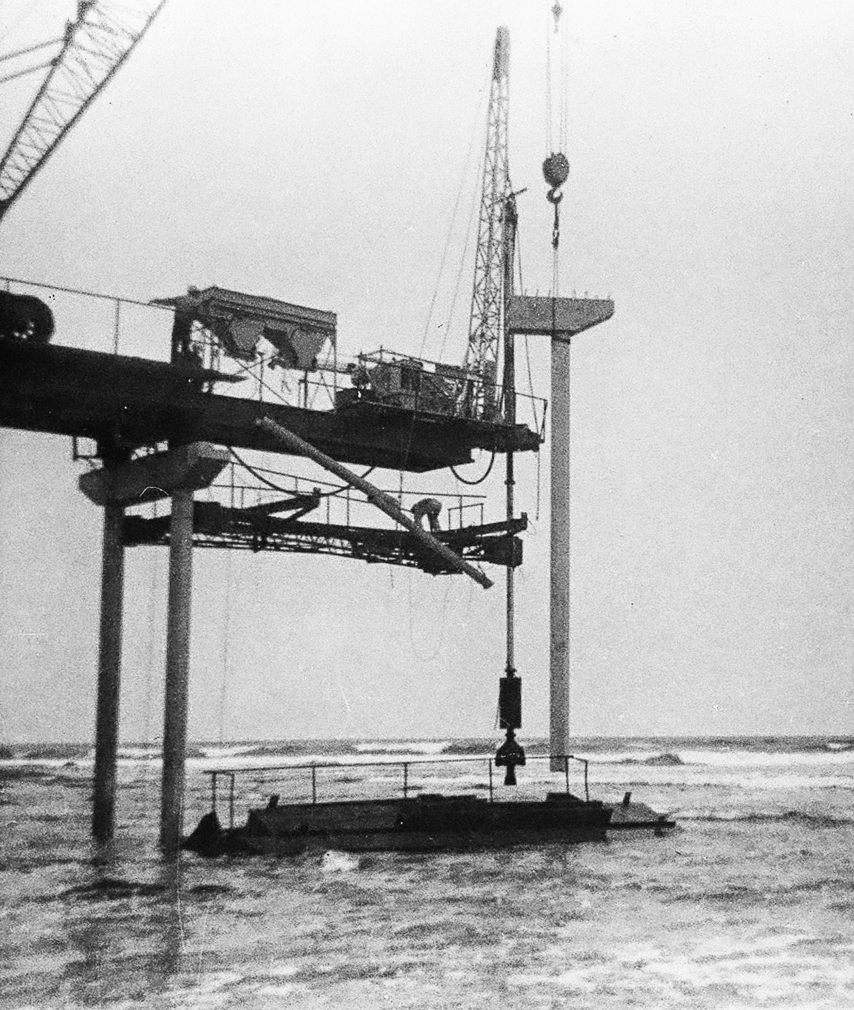
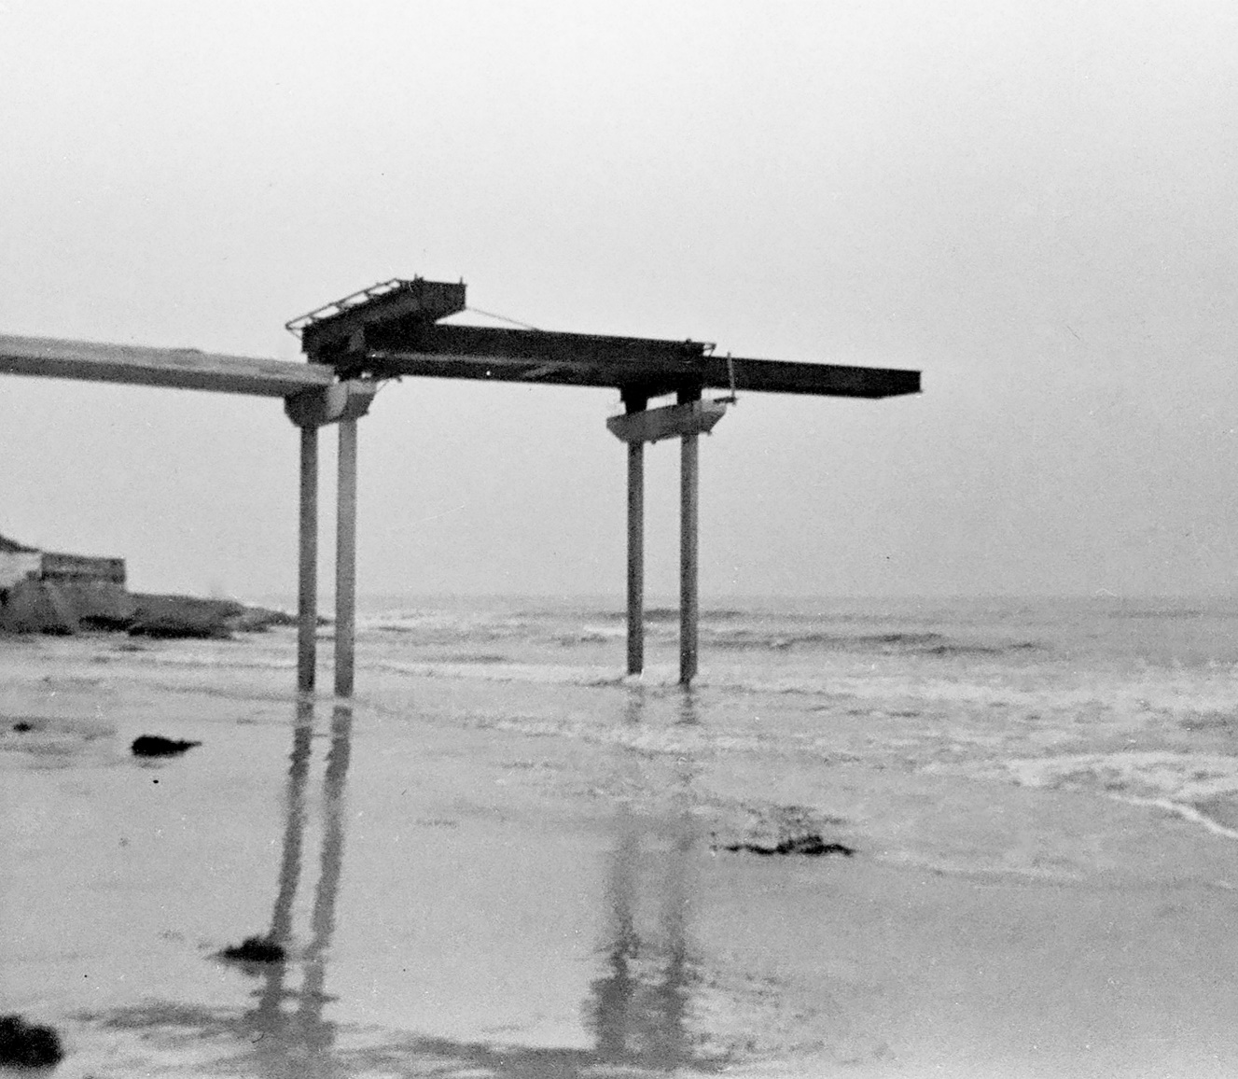
The Equipment & Tools - Hoppers, Tremmie, Work Platform
3 Construction

Slide 21
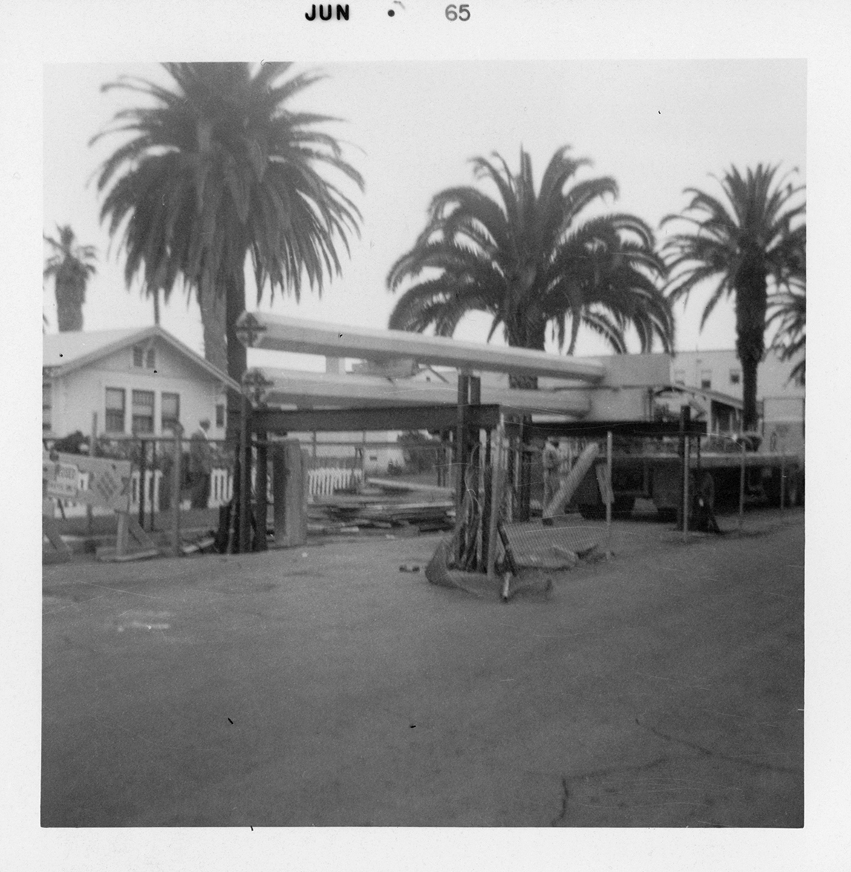
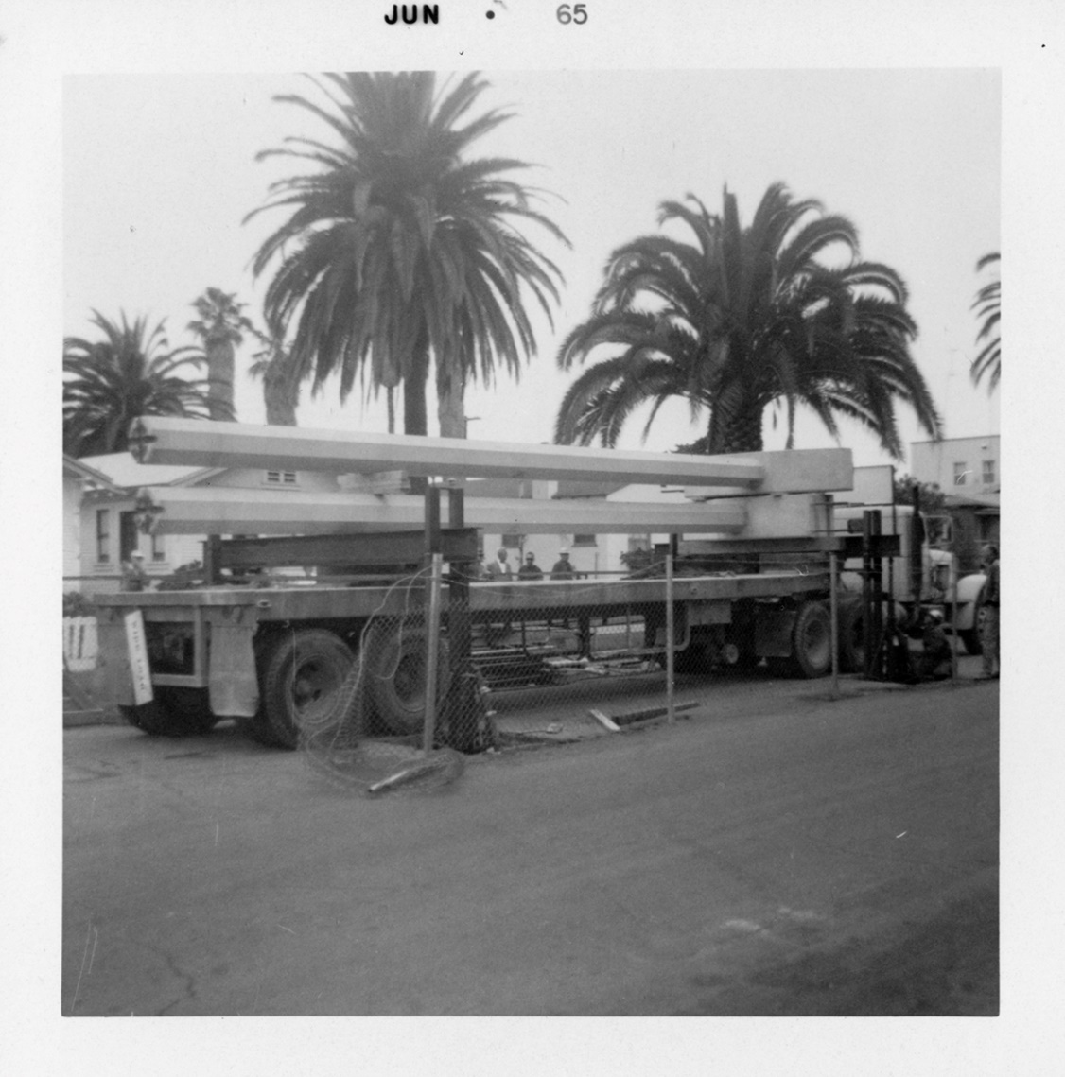
The Equipment & Tools - Hydraulic Transfer Racks
3 Construction

Slide 22
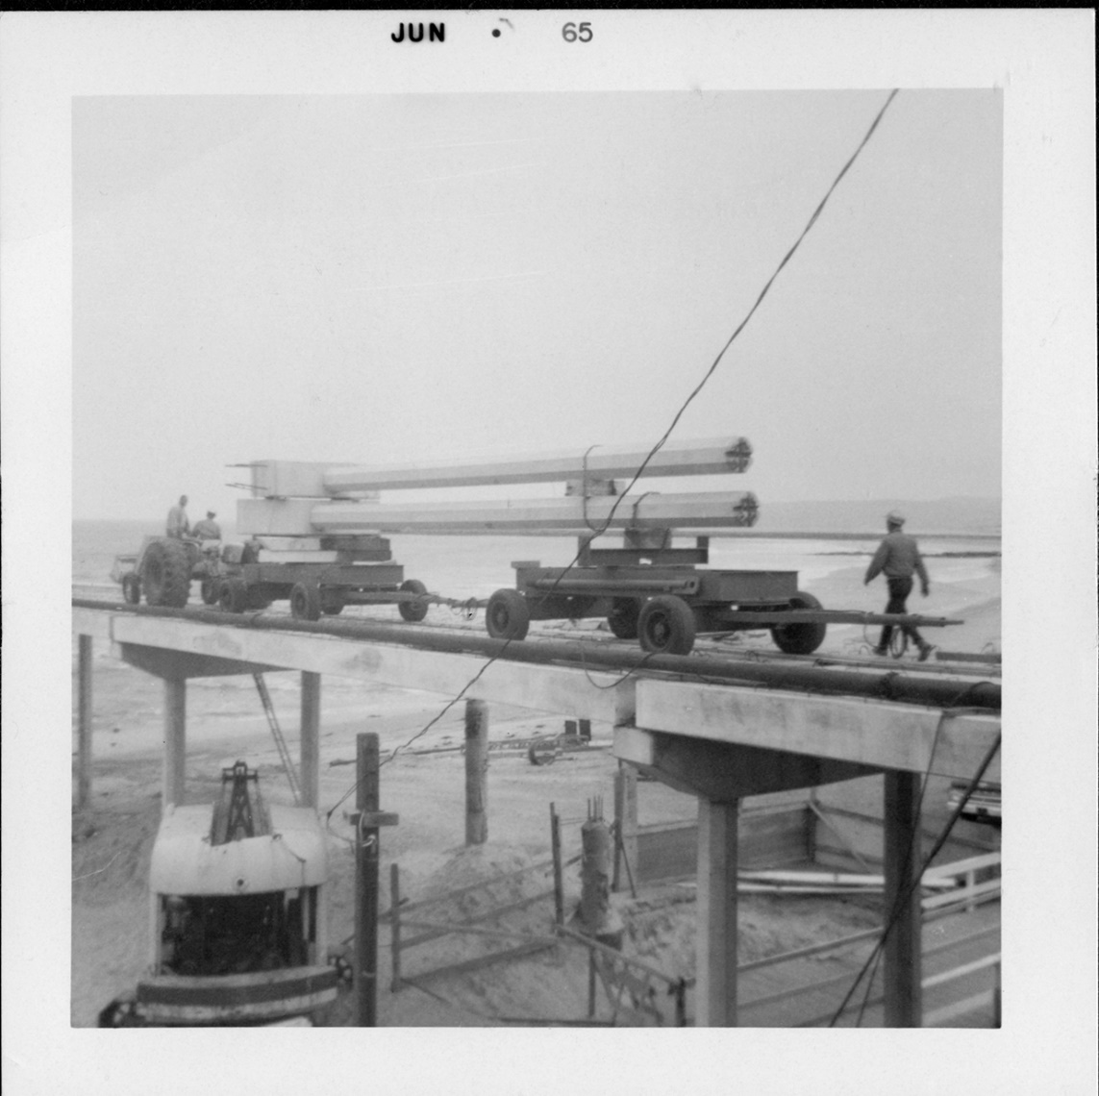
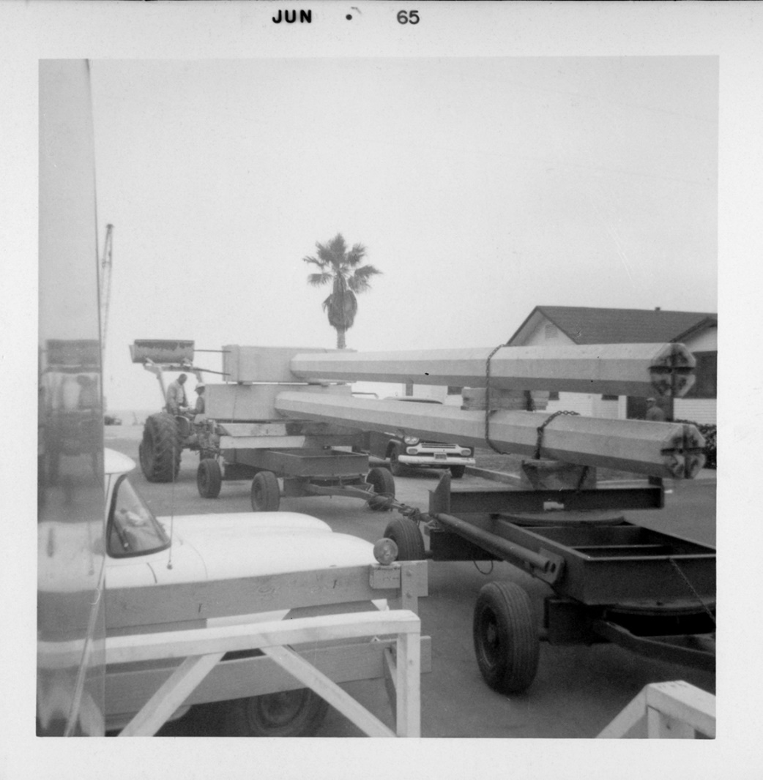
The Equipment & Tools - Trailer Dollies & Tractor
3 Construction

Slide 23
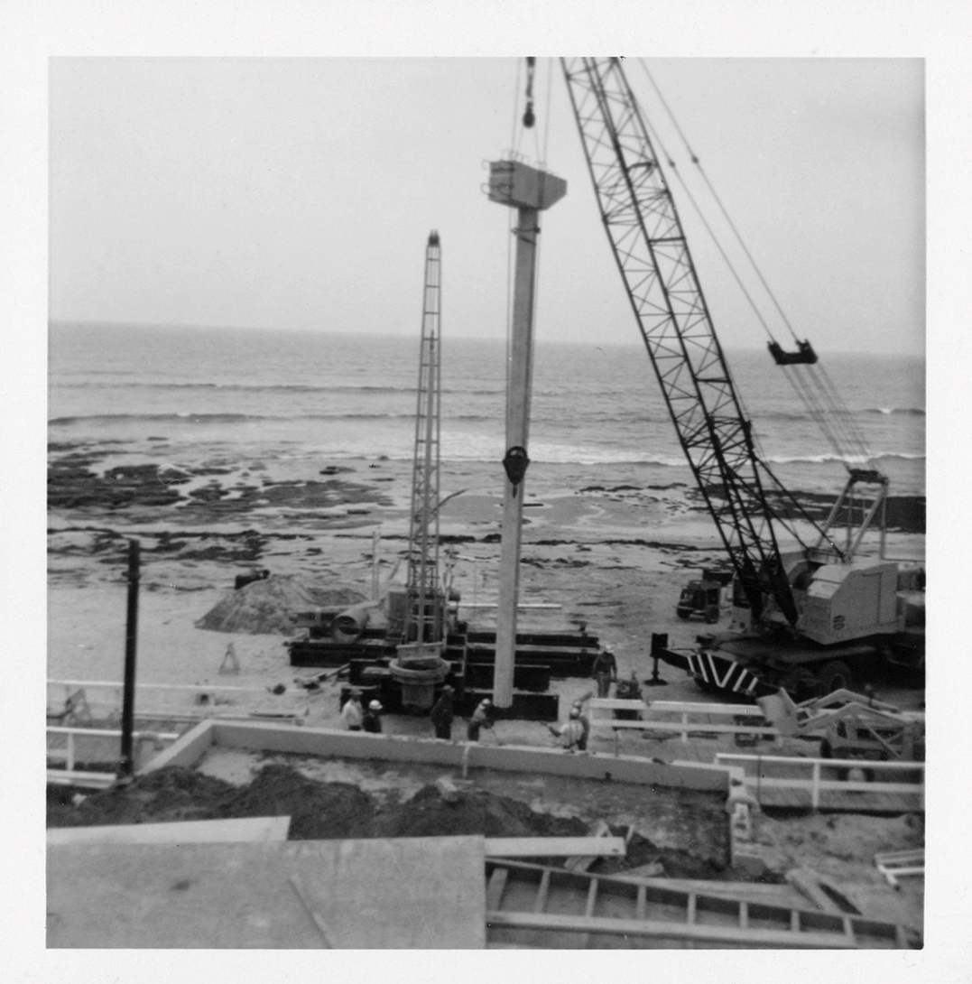
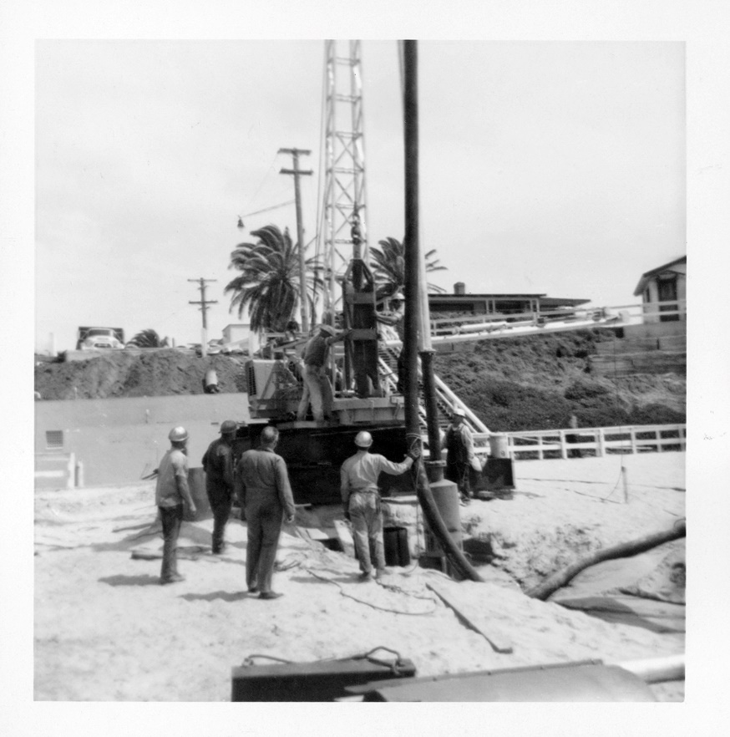
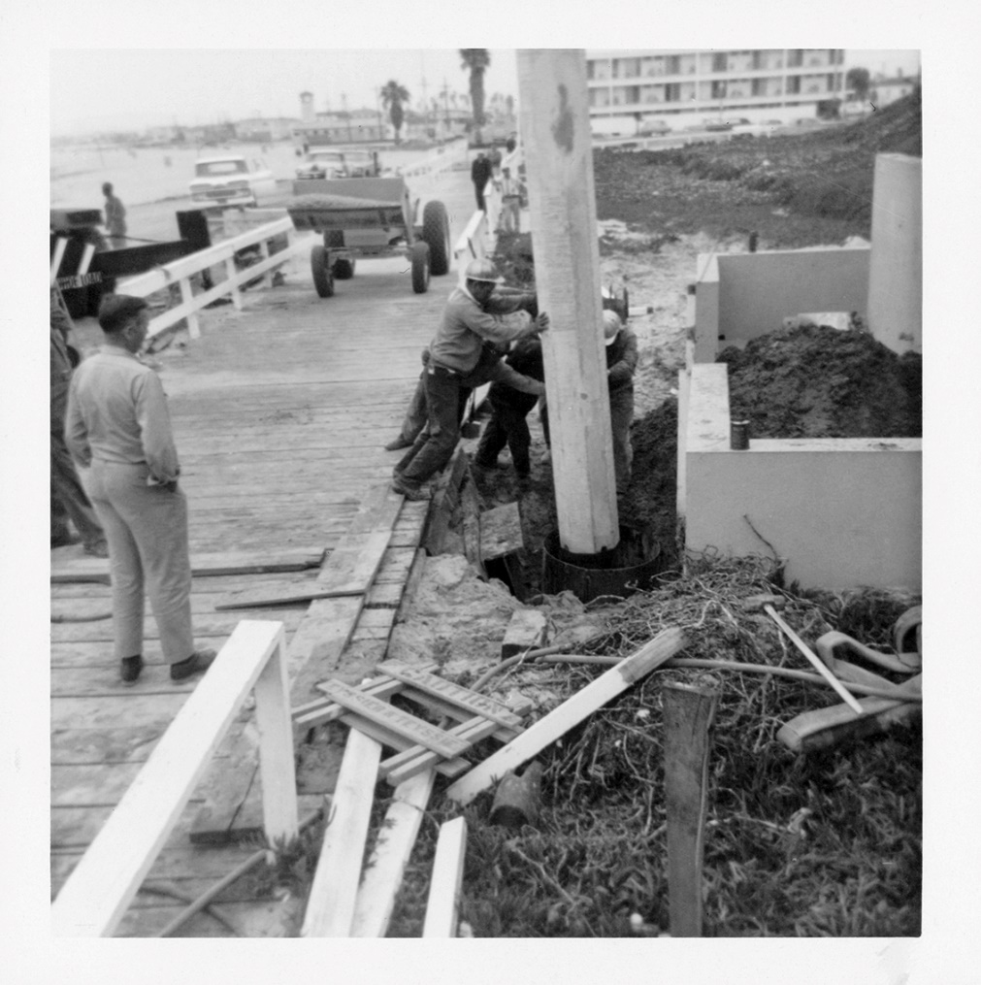
Construction – Starting at the beach
3 Construction

Slide 24
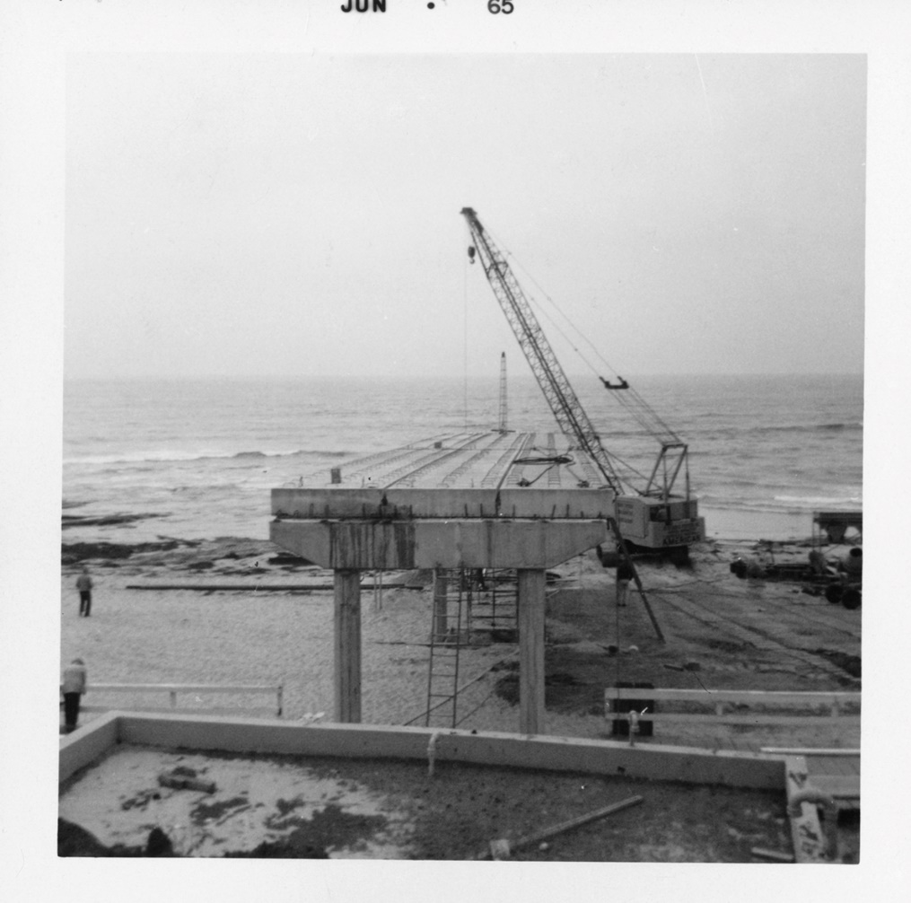
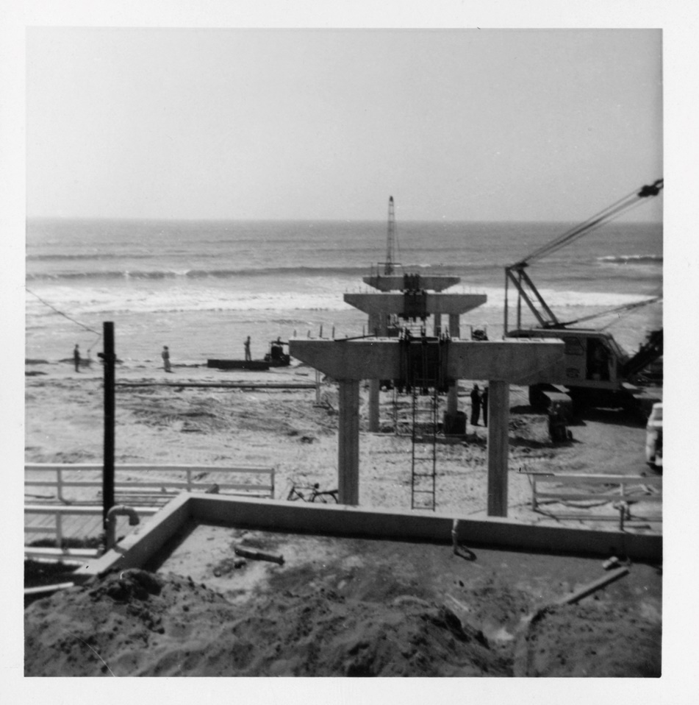
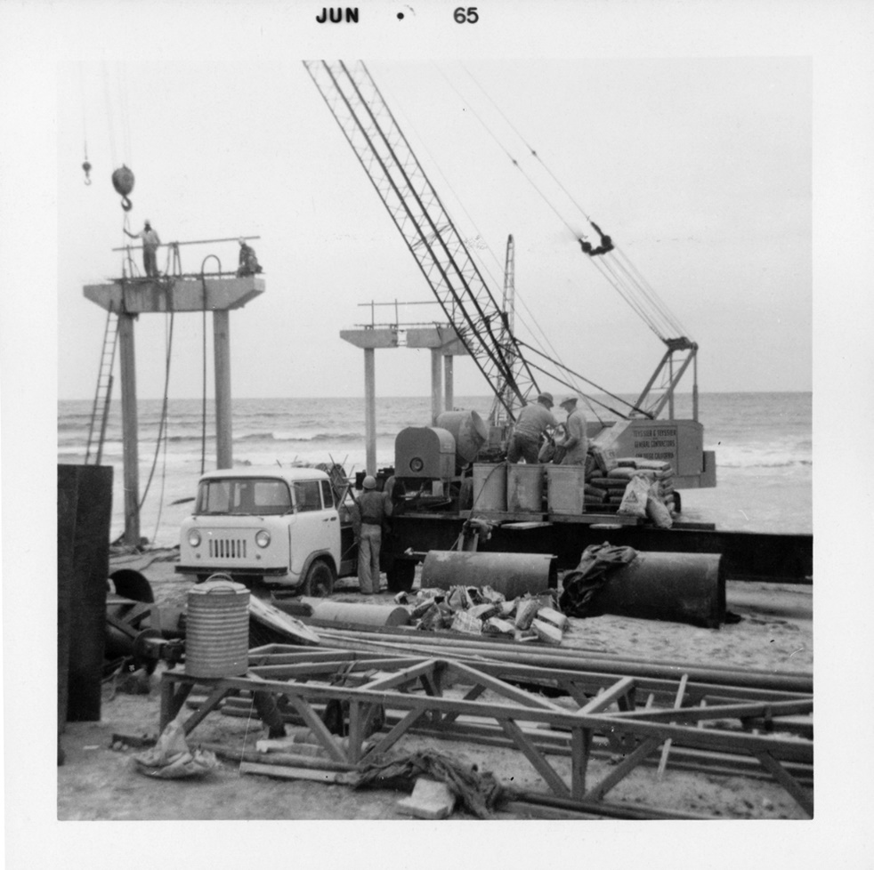
Construction – Starting at the beach
3 Construction

Slide 25
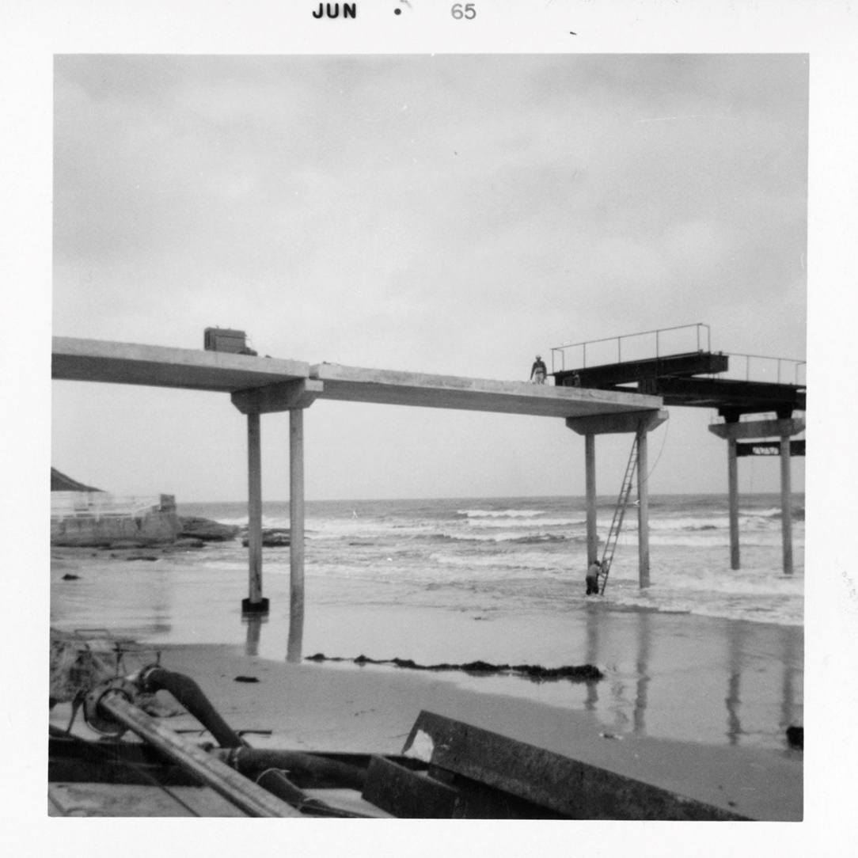
Construction – Starting at the beach
3 Construction

Slide 26
Construction – Picking up (the pace)
3 Construction

Slide 27
Construction – All hands (and equipment) on deck
3 Construction

Slide 28
Construction – The Guys On the front lines -
3 Construction

Slide 29
Construction – The Guys On the front lines -
3 Construction

Slide 30
Construction – All decked out
3 Construction

Slide 31
Construction – All decked out
3 Construction

Slide 32
Construction – All decked out
3 Construction

Slide 33
Construction – Completed
3 Construction

Slide 34
Thank you! (OB rocks!)
Birthday Wishes All Around!
OB Pier turns 50; Leonard Teyssier turns 89
Special Thanks to:
Ocean Beach Historical Society
Ocean Beach MainStreet Association
Moffatt & Nichol, Consulting Engineers
Craig Deutsch
Leonard Teyssier and Teyssier & Teyssier, Inc.
The End

